Slide 1
COSC 5/4735
templating with Handlebars

Slide 2
Templating with Handlebars
Templating can be best described for form letters. There are spots that get filled with the data, while the rest is the same.
While server-side templating is quickly being supplemented by frontend frameworks like React it still has applications
  it also prevents the users from being able to see all the information, since server side, just gives them a page.

Slide 3
Templating with Handlebars
The problem boils down to this: switch context is problematic
If you’re writing JS it can be annoying to mix in HTML
Having JS emit HTML has problems:
Constantly worry about characters to be escaped
Using JS to generate HTML including JS is… silly
Usually this results in a loss of syntax highlighting
Harder to spot malformed HTML
Code is visually hard to parse

Slide 4
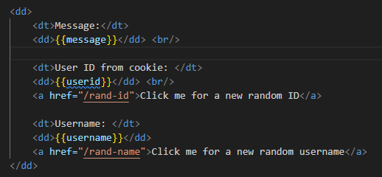
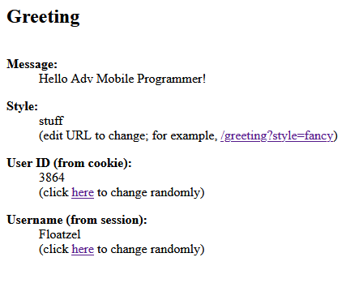
Templating with Handlebars
Templating solves those problems by allowing you to write in the target language
While at the same time providing the ability to insert dynamic data, as we saw last time.

Slide 5
Choosing a Template engine
In node there are near limitless choices when selecting a templating engine
There are some primary criteria to be considered when doing so:
Performance
Client, server, both
Abstraction
These are some prominent, many templating engines are mature at this stage
Express allows you to use any templating engine you wish
Notes:
Performance
Clearly, you want your templating engine to be as fast as possible. It’s not some‐
thing you want slowing down your website.
Client, server, or both?
Most, but not all, templating engines are available on both the server and client
sides. If you need to use templates in both realms (and you will), I recommend
you pick something that is equally capable in either capacity.
Abstraction
Do you want something familiar (like normal HTML with curly brackets thrown
in, for example), or do you secretly hate HTML and would love something that
saves you from all those angle brackets? Templating (especially server-side tem‐
plating) gives you some choices here.

Slide 6
Handlebars Basics
Handlebars is an extension of Mustache
Handlebars has easy JS integration, on both the front and backend
They key to understanding templating is the concept of context
When you render a template, you pass the templating engine an object called the context object
This context object allows replacements to work

Slide 7
Handlebars Basics
For example you can have this context object:
With a corresponding template:
Then {{message}} will be replaced with ‘hi class!”
But what if you want to pass HTML instead?
To do so you would need to change the template to be:
Then, HTML can be supplied in the context object

Slide 8
Comments
There is a difference between HTML and handlebars comments
You can still use <!-- html comment -->
Or you can use {{! Handlebars comments}}
IF this is a server side template the Handlebars comment won’t be sent to the client, but the HTML comment will still be sent
Default to Handlebars comments for things you don’t want shared out

Slide 9
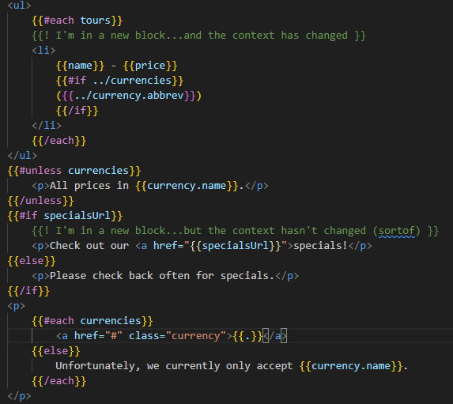
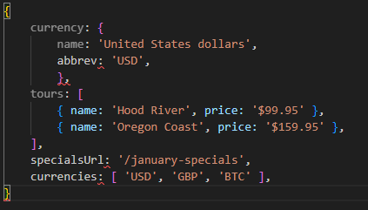
Blocks
Blocks are the next level of complication
Blocks provide flow control, conditional execution, and extensibility

Slide 10
Blocks
There is a lot happening in this template, so we can break it down
It starts with the each helper, that iterates over an array
Between `{{#each tours}}` and `{{/each tours}}` the context changes
On first pass it is `{ name: ‘Hood River’, price: ‘$99.95’}
Then it changes to `{ name: ‘Oregon Coast’, price: ‘$159.95’}

Slide 11
Blocks
If we want to access the currency object `../` is needed to access the parent context
If the property of the context is itself an object, we can access its properties as normal with a period

Slide 12
Blocks
Both `if` and `each` have an option `else` block
There is also an `unless` helper function
This is akin to a negated if statement
This template uses `{{.}}` in the `{{#each currencies}}` block
`{{.}}` refers to the current context
Notes:
(with each, if there are no elements in
the array, the else block will execute).
Accessing the current context with a lone period has another use: it
can distinguish helpers (which we’ll learn about soon) from prop‐
erties of the current context. For example, if you have a helper
called foo and a property in the current context called foo, {{foo}}
refers to the helper, and {{./foo}} refers to the property.

Slide 13
Server-Side Templates
Server-side templates allow you to render HTML before it’s sent to the client
Unlike client-side templating, where the templates are available for a curious user, users will never see the server-side template
Server-side templates support template caching
The templating engine will cache compiled templates (recompiling only when the template changes)

Slide 14
Server-Side Templates
By default view caching is disabled in development mode and enabled in production
If you want to explicitly enable it: `app.set(‘view-cache’,true)`

Slide 15
Views and Layouts
A view usually represents an individual page on a website
It can also represent an AJAX-loaded portion of a page
Express looks for views in a views directory
A layout is a special kind of view, essentially a template for templates
Layouts are essential because mosty pages will have a consistent layout
Layouts include a space for the views to be put

Slide 16

Using Layouts (or not) in Express
Very likely many pages developed for a project will use the same layouts
So, it doesn’t make sense to continually specify a layout each time a view is rendered
When the view engine is created a name can be supplied for the default layout
You can manually supply a different layout when rendering a view if you need

Slide 17
Sections
A technique from Microsoft’s Razor template engine, a section
Layouts work well if all the views fit nicely within a single element in a layout
What happens when your view needs to inject itself into a different part of the layout?
A common example of this is a view needing to add something to the <head> element or insert a <script>

Slide 18
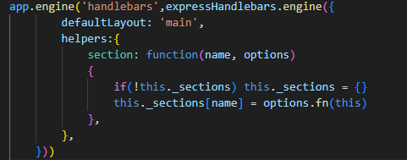
Sections
Neither Handlebars or express-handlebars has a built in way to do this
Handlebars helpers however make it quite easy to do
Once this helper is in place, the section helper can be used in a view

Slide 19
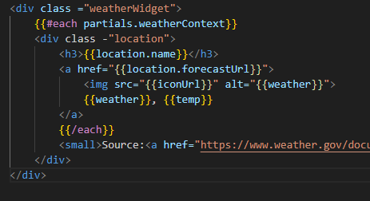
Partials
Often you’ll have components that you want to reuse on different pages
One way to achieve this with templates is using partials
Suppose you want to get a weather readout on the homepage, to display the current weather
This component needs to be reusable so it can be added to whatever page
First, a partial is needed in /views/partials
Notes:
partials (so named because they don’t render a whole view or a whole page).

Slide 20
Partials
We want weather data to be available in any view
It isn’t practical to pass in the context for every view, so res.locals can be used
It is available to very view
We don’t want to interfere with the context specified by individual views, so we put all partial context in a partial object
To make the weather available to any view middleware is the best bet
This middleware will inject weather data into `res.locals.partials`
Notes:
express-handlebars allows you to pass in partial templates as part
of the context. For example, if you add partials.foo = "Tem
plate!" to your context, you can render this partial with {{>
foo}}. This usage will override any .handlebars view files, which is
why we used partials.weatherContext earlier, instead of parti
als.weather, which would override views/partials/weather.handle‐
bars.

Slide 21
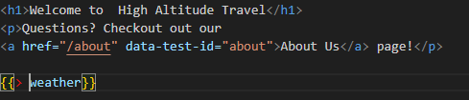
Partials
Once everything is set up the partial needs to be used in a view
To put a widget in the homepage, /views/home.handlebars
The `{{> partialname}}` syntax is how a partial is included in a view
Handlebars knows to look in /views/partials

Slide 22
References and resources
this lecture heavily references the Web Development with Node and Express, Chapter 7
  Example code is based on the books, so you use the books website or
all example code can be found in the class github repo
  https://github.com/JimSeker/nodejs/lectuer4

Slide 23
Q
A
&

