Slide 1
React
Developing a front end with React.
More State and Forms.

Slide 2
Context API
Passing data
  Passing props is a great way to explicitly pipe data through your UI tree to the components that use it.
  But this lead components ancestors being far removed and state needed to be lifted up (ie moved to higher and higher-level components that don’t necessary need it.)
Context lets a parent provide data to the entire tree below it, without passing props down the tree.
  And any components that don't need it, don't declare it.
  uses useContext to get the value, and createContext to set the value.

Slide 3
createContext
Do use the context API, we need to create and export a context.
import { createContext } from 'react';
export const MyDataContext = createContext(value);
  the value can be a simple value, like a number or as complex as you need.

Slide 4
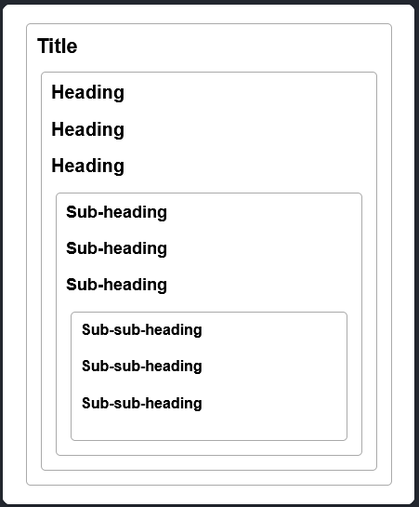
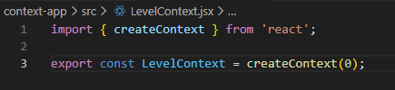
Example
Using react doc's example →
  We want to create stand alone Components with out props.
    A Heading component that choose h1, h2, etc.
    it uses the data from the context to decide which one on to use.
So, in case, we need a level value

Slide 5
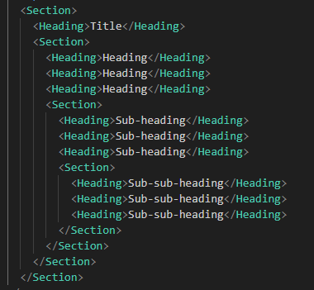
Example (2)
In the "main" section, we can build components like this, Section sets context

Slide 6
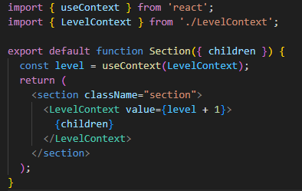
Example, Section
section imports the levelcontext
and then gets the context via useContext
Any components wrapped in <levelContext …> </Level> have access to the context
  From previous slide, heading component, but we could add more that would have access as well.
Note, the children prop here for Section contains Heading and Section components.

Slide 7
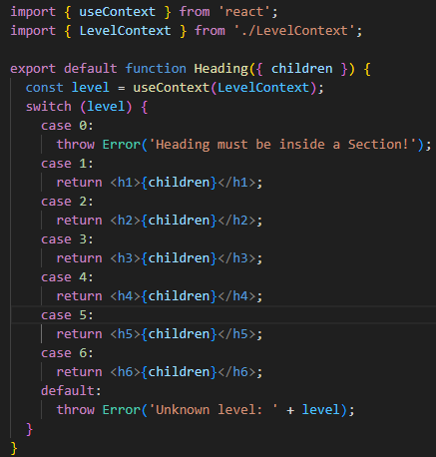
Example, Heading
at the heading component
  get the level via useContext
  return the correct Heading, based on the level value using the children prop as the value.
A note, this could have also been done with level prop as well.
Note, prop children has the value of Title, Heading, sub-heading, or sub-sub-heading. See first slide of example.

Slide 8
Context
Context is based used for "global" values that would be needed by most if not all the components in your app.
  Theming, current account (ie logged in user), Routing (see later), or managing state, where distant components need ways to change higher up components.
    It is common to use a reducer together with context to manage complex state and pass it down to distant components without too much hassle.
The previous example, had no way (or need) to change the value and redraw, so next example we use theme that changes the components' theme to light/dark mode.

Slide 9
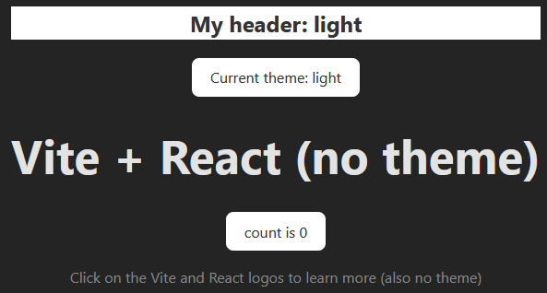
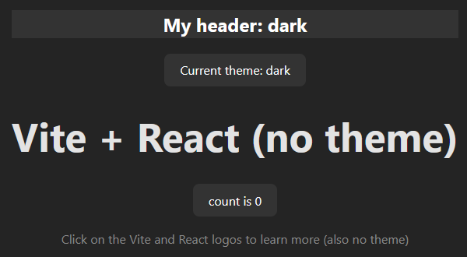
Theme and context
using a button, it can change the theme from light to dark or dark to light.
Besides the value, we also need a setter as well.

Slide 10
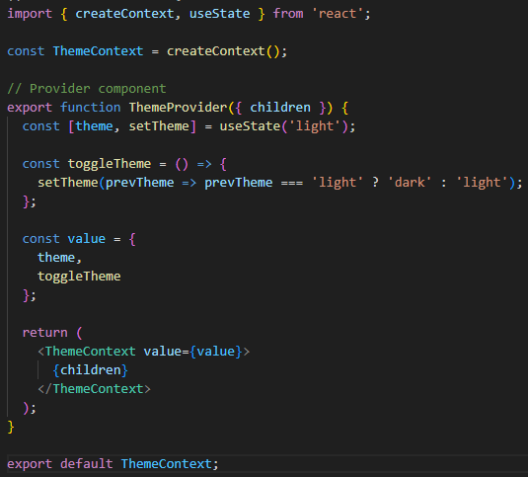
Context for Theme example
Create context, themeContext
  createContext, ThemeContext
  We need a variable theme and setTheme (via useState)
    When state is triggered, a redraw will happen
then pass both theme and toggleTheme via the ThemeContext to children components

Slide 11
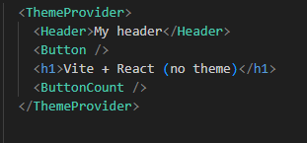
Top level.
The components Header, Button, and ButtonCount are wrapped in ThemeProvider
  along with h1 which doesn't use it.

Slide 12
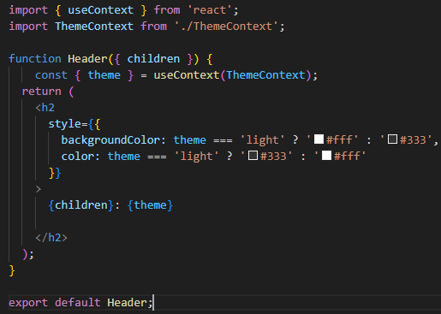
theme: header component
header
  use theme to determine which style is used for the colors
  light or dark them.
  otherwise, display the children in a h2 value.
  also displays theme.
  which style should be in css, we switch between 2 (or more) css, instead of manually writing style.

Slide 13
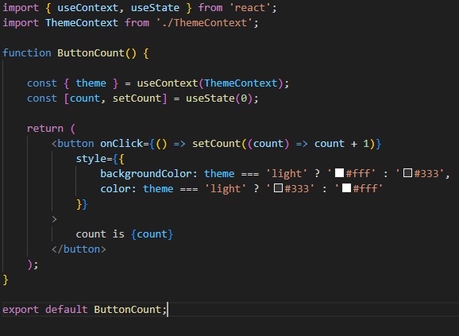
theme: ButtonCount
using the default example from vite with a button.
  adding theming and moving to it's own file
  it looks the same, with the extra context and style.

Slide 14
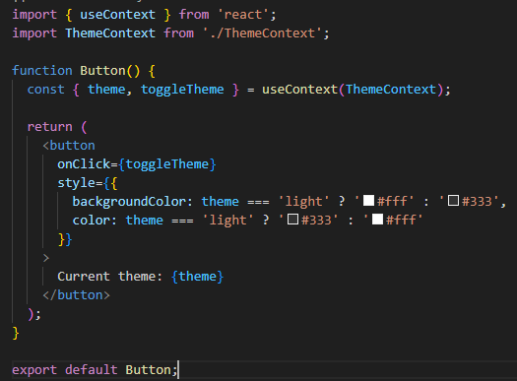
theme: Button
This button change the theme
it's useContext declares both theme and toggleTheme
then toggleTheme is used in the onClick method.
which triggers state and a redraw.

Slide 15
state management
local state (useState)
  Form inputs
  UI toggles (modals, dropdowns)
  Component-specific state
  Temporary data
Global/Remote State:
  User authentication
  User profile
  Application settings
  Theme preferences
  API data (users, posts, etc.)
  Real-time data

Slide 16
useReducer
The useReducer hook in React is very similar to useState, but it lets you move the state update logic from event handlers into a single function outside of your component.
It centralizes state-update logic in a separate function, making the component code cleaner and the updates easier to debug and test
  useState vs useReducer
    useState for simple independent values like toggles, input fields, etc.
    useReducer when multiple pieces depend on either other, or multiple useState hooks come together.
  useReducer also work well with useContext and router.

Slide 17
useReducer (2)
reducer is a pure function that receives the current state and an action, then returns a new state.
  typically, it uses a switch/case statement to deal with the action when called. each one returns a different state.
dispatch is the function you call to update state, based on an action object

Slide 18
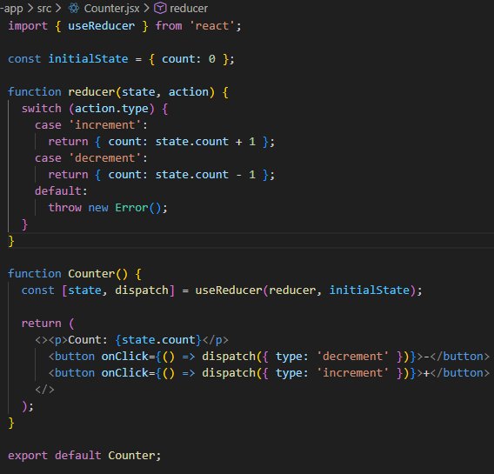
simple example
initialState, could also be passed as a prop to the function Counter.
The reducer takes current state and an action
  then returns a new state
  remember this is a pure function.
Counter
  declares the reducer and uses the dispatch in the buttom for + and -

Slide 19
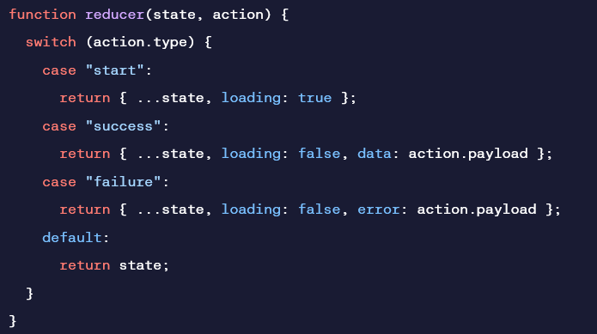
More likely example
fetch data from an API can useReducer to manage loading, success, and failure
Before calling the api
  dispatch ({type: "start"});
when it comes back in async
  dispatch({type: "success", payload: returnedData});
and redraws
const [state, dispatch] = useReducer(reducer, {loading: false, error: null, data: null}); //and lots more.

Slide 20
Scaling up with Reducer and Context.
Reducers let you consolidate a component’s state update logic. Context lets you pass information deep down to other components. You can combine reducers and context together to manage state of a complex screen.
We see this used in the next part, with forms.

Slide 21
useEffect
The useEffect hook in React lets you perform side effects in functional components, such as fetching data, manipulating the DOM, or setting up event listeners.
It runs after the component renders and the browser has painted the screen, which helps prevent blocking the rendering process.
useEffect( () => {
//This code runs after the component renders (the side effect)
… //don't change state or likely infinite loop!
return () => { … }; //optional cleanup function
}, [variable]); //dependency array. What triggers the side effect.
//note [] can be an array of values or blank.
//if blank runs every time, performance issues can occur.

Slide 22
Forms and state

Slide 23
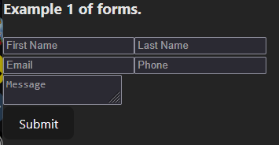
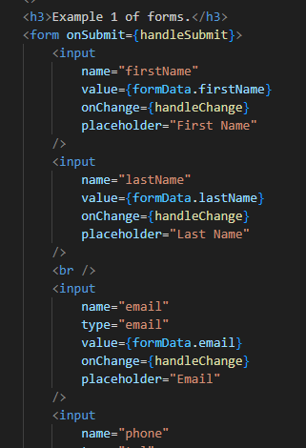
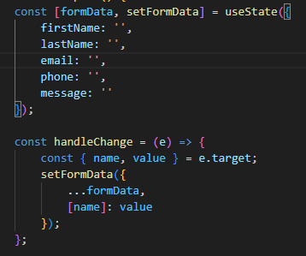
Forms.
single input require a state variable to hold the data. for complex multiple input forms, we need state with object.

Slide 24
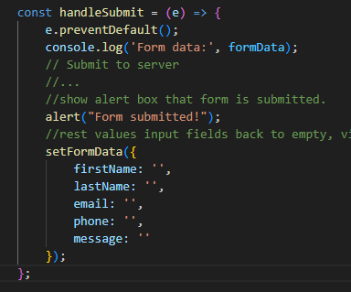

Forms (2)
submit button is simple, but you can add to it or use default.
a function named handleSubmit is needed, as listed in the form.
submit to server is left blank and is part of r3 lecture.

Slide 25
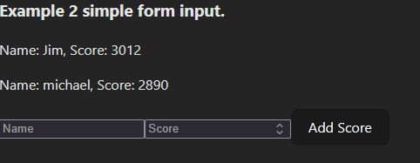
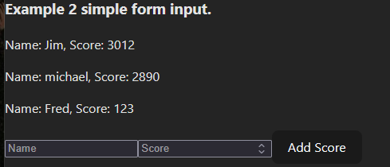
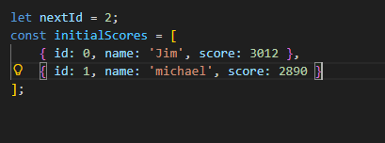
forms and displaying data.
Using state and adding information to the page.
In this example, page starts with 2 pieces of data already, Jim and Michael scores.
  We can add more, which is add to a data structure and changing state to redraw the new data.

Slide 26
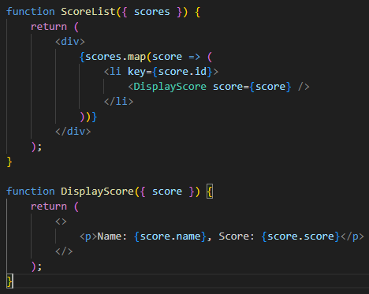
Displaying the data
We have an array of data
using ScoreList that take the array, and the map function to loop through the array
Using the <li >
  we need the ID to work as the key for the list.
  call Display to display each score

Slide 27
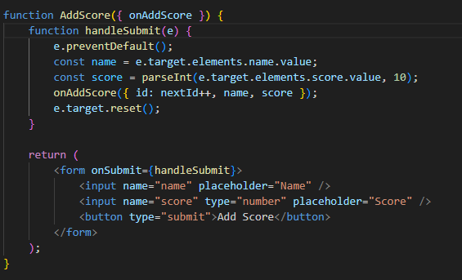

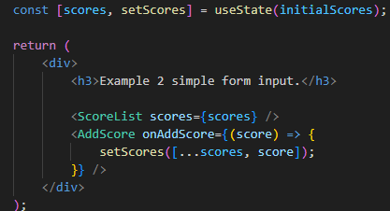
Adding to the data
using a simple form
plus useState
  when a uses press add score, then new data will be displayed.
Importantly, setScore for the useState is passed AddScore function as the updater,
  So state is changed and a redraw is triggered.

Slide 28
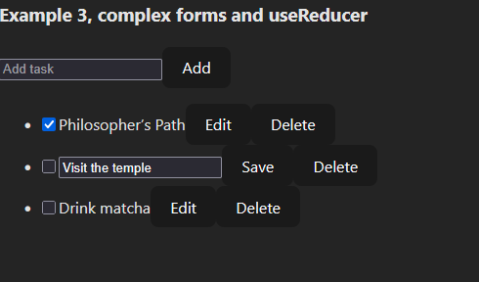
More complex
With more complex forms and data structures
  likely change from useState, to useReducer and dispatch.
  But likely still use useState in the less complex part of the forms as well.
  Add task uses state, for form, but add button
    uses dispatch, to trigger redraw
  Edit/save is state for drawing and form
  while the save and delete button trigger
    using a dispatch command, since we need
    a full redraw.
  See the example code in
  nodejs/react2/Example3.jsx

Slide 29
References and resources
https://react.dev/
https://react.dev/learn
https://www.w3schools.com/react/react_jsx.asp
https://react.dev/reference/react-dom/components
https://react.dev/learn/passing-data-deeply-with-context#
https://react.dev/learn/scaling-up-with-reducer-and-context
https://react.dev/learn/sharing-state-between-components
https://mimo.org/glossary/react/usereducer-hook
Example code:
  https://github.com/JimSeker/nodejs/tree/main/react2

Slide 30
Q
A
&

