Slide 1
COSC 5/4735
Node.js: Server Side.

Slide 2
Quick Note
JavaScript was developed for a web browser (client side). So, you will see a lot about tags <script> and even about the DOM
  The Document Object Model (DOM) is a programming interface for web documents. It represents the page so that programs can change the document structure, style, and content.
    The DOM represents the document as nodes and objects; that way, programming languages can interact with the page.
And I'm skipping over all the client side for now. Node.js is our environment to run on the server side. We'll see client side again with React.js.

Slide 3
Getting started with Node

Slide 4
Node.js
You can use any platform you want; I'd suggest use the LTS version
  currently v24.x, but some platforms like Pi are using 18.20
  https://nodejs.org/en for windows
  sudo apt-get install nodejs
    for any ubuntu (and Pi).
    https://nodejs.org/en/download using nvm to install any vision.
Most things are done on the terminal to run node
  you can use any ide that makes you happy, but vscode is likely the best option.

Slide 5
npm
npm is the ubiquitous package manager for Node packages (how we will get and install Express)
A package manager’s two primary responsibilities are:
Installing packages
Managing dependencies
npm is fast, capable, and painless

Slide 6
npm
npm is installed when node is installed
The primary command when using npm is install
For example, to install nodemon (which restarts a Node program when the source code is changed) you would type `npm install -g nodemon`
The -g flag tells npm to install it globally, which is different than locally
We’ll talk about local installations when we talk about package.json
Utilities like nodemon are good to install globally
Packages specific to an application should be installed locally

Slide 7
Nodejs and sever side.
When we talk about node.js and sever side
  what we really mean is writing a web server!
This is a paradigm shift from web services. Normally we write the code for a webpage in html and/or a scripting language like PHP, which is interrupted by the webserver (apache, ngnix, IIS)
  /index.html is a file, /query.php is another file, etc
In node, you have a script file(s) and then it does all the work.
  and it looks nothing like a traditional web server directory structure.

Slide 8
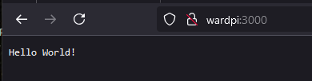
Node and web server
Node makes it easy to get server up with a few lines of code.
command: node helloword1.js
  command line output
  server started on port 3000; press Ctrl-C to terminate ....
use a browser to go the site
http://localhost:3000
  or name of the machine if you are working remote.
"use strict";
const http = require('http');
const port = process.env.PORT || 3000;
const server = http.createServer((req, res) => {
res.writeHead(200, {'Content-Type': 'text/plain' });
res.end('Hello World!');
});
server.listen(port, () => console.log(`server started on port ${port}; ` +
'press Ctrl-C to terminate ....'));

Slide 9
Event-Driven Programming
The core philosophy behind node is event-driven programming
This means that as a programmer you need to understand what events are available to you, and how to respond to them
  Many people are introduced to event-driven programming through a user interface
  The user clicks something and you handle the click event
  You have no control over when a user may click something, so it is a good example

Slide 10
Event-Driven Programming
It can be a little harder to make the conceptual leap tp responding to event son the server, but the principle is the same
In the previous code example the event is implicit
  the event that's being handled is an HTTP request
  The http.createserver method takes a function as an argument
  That function is invoked every time an HTTP request is made
  The program just sets the content type to plain text and sends the string “Hello world”

Slide 11
Routing
Routing refers to the mechanism for serving the client the content it has asked for
For web-based client/server applications the client specifies the desired content in the URLs
Specifically the path and the query string
  http://localhost:3000/about
We can expand the Hello World to be more interesting
Let’s modify it to server a minimal website consisting of:
A homepage
An about page
A not found page

Slide 12
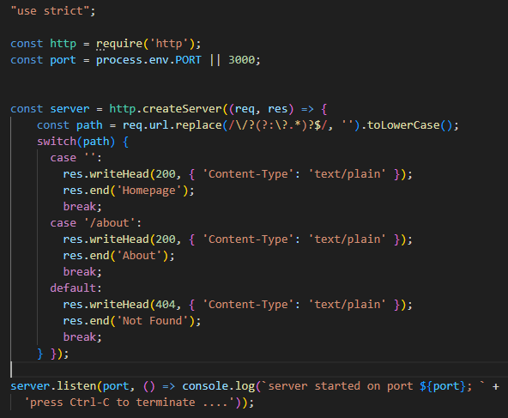
Routing
Running this will again generate a webserver at http://localhost:3000
But now you will also be able to navigate to http://localhost:3000/about
And any paths we aren’t handling will give a 404 error
helloworld2.js

Slide 13
Serving Static Resources
Now that we’ve got some simple routing working we can serve some real HTML and a logo
These are called static resources as they don’t usually change
If you’ve worked with Apache or IIS you may be used to just creating an HTML file, navigating to it, and having it delivered to browsers automatically
Unfortunately Node doesn’t work like that so files will need to be manually read and then sent

Slide 14

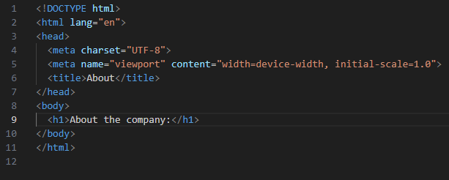
Serving Static Resources
To serve files statically you first need a directory to hold your html or image files in
A public directory for the html files
A img directory for any images
Add some generic html files in the public directory and an image for a logo

Slide 15
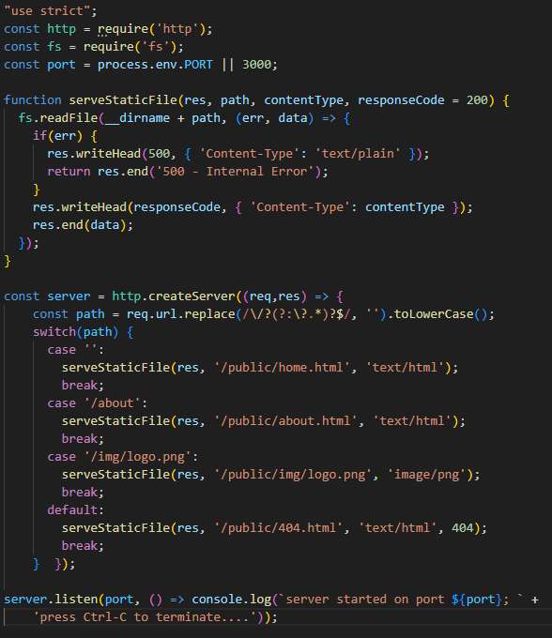
Serving Static Resources
Adding a helper function helps to reduce redundancy in our code
fs.readFiles is an asynchronous method for reading files
This function uses the callback pattern
You provide the callback function and when the work has been done that function will be invoked
helloworld3.js

Slide 16
Serving Static Resources
In this case fs.readFile reads the contents of the specified file and executes the callback function when the file has been read
If the file doesn’t exist or if there were errors the err variable is set
If the file is successfully read then it is sent to the client with the specified response code

Slide 17
Onward to Express
So far, Node may seem relatively basic it only replicated what Apache or IIS already do
But this is just the jumping off point to more in depth applications
Writing more and more advanced Node applications may be more impressive, but ultimately we would end up with Express!

Slide 18
ES6 module format vs common js format.
CommonJS is the older format, both are used in node. but you need to pick one. .js or .mjs (both … not really).
ES6 uses import and export, commons use require and module.exports or exports
Firebase uses ES6, so much of my code is in the ES6 format.
  in Express we can set the default type and use the .js extension.
https://stackoverflow.com/questions/77120722/commonjs-vs-es-modules-for-express-node

Slide 19
You working environment.
I'm running everything on a single system, specifically a raspberry Pi.
  Vscode connects remoting to the pi and I use the machine address for the webpages.
Windows (NOT WSL)
  You can install nodeJS (for windows), then any databases will also be installed windows machine. VS code when then open a local directory in windows. everything runs on a powershell/DOS command prompt.
    web browser uses http://localhost:3000/

Slide 20
You working environment (2)
Windows with WSL (ubuntu app)
  install WSL/ubuntu. install NODE.js into ubuntu (apt-get install version)
    Also make any databases and other apps are installed in ubuntu, not windows
      WSL can not talk to windows apps directly, so everything needs to be inside WSL.
      It maybe easier to install Vscode into WSL. It can run via windows from WSL.
  Vscode can be run from windows, talk to wsl projects.
    from windows, you see the linux part of the windows filesystems
    in linux, use the /mnt/c to see the windows file system.
  node.js apps run from inside wsl. web browser on the local windows machine uses http://localhost:3000/
    But make sure localhostForwarding is not turned off. (search bar: wsl settings Network tab, then local host forwarding)
    hibernating windows can break the port forwarding. In an admin windows command prompt, restart wsl
      wsl –shutdown
      wsl

Slide 21
References and resources
this lecture heavily references the Web Development with Node and Express, Chapter 2
  Example code is based on the books, so you use the books website or
all example code can be found in the class github repo
  https://github.com/JimSeker/nodejs/lectuer1

Slide 22
Q
A
&

