Slide 1
Cosc 4735
Flutter
a few more widgets

Slide 2
code and examples.
all the code and examples are taken form the moreui demo in the flutter repo.
Also, for a preview of material design 3 widgets see
  https://github.com/flutter/samples/tree/main/material_3_demo

Slide 3
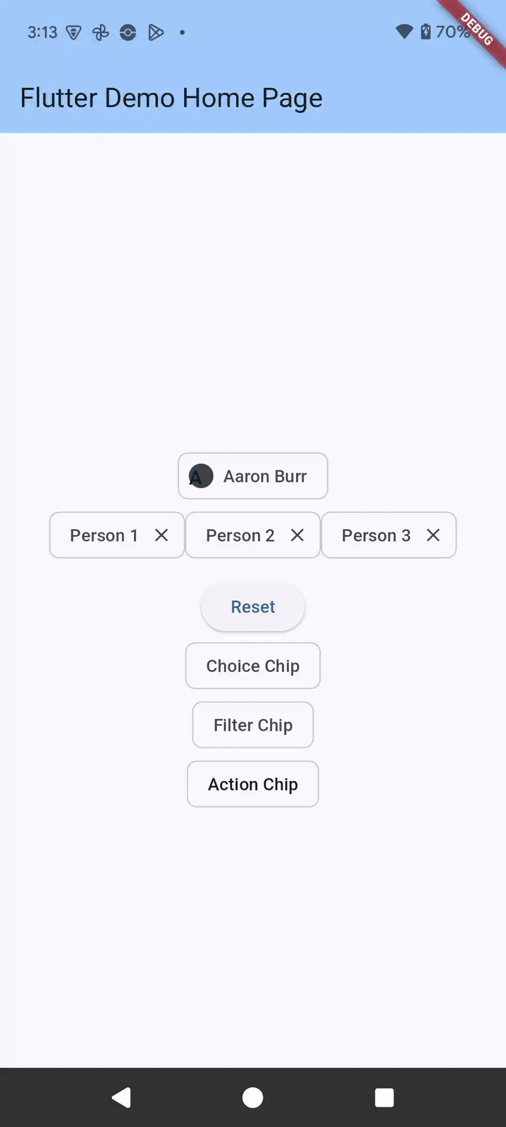
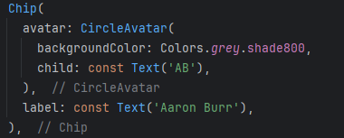
chip
Chips are compact elements that represent an attribute, text, entity, or action.
There is chip, Inputchip, FilterChip, ActionChip (think button), choiceChip.
  adding a onDeleted: will cause the chip to have x to delete the chip as well.

Slide 4
inputChip
the input check will have
  onSelected: () { }
  selected: true/false
    if true, shows a check mark
  optional
  onDeleted: () {}
    call the method, which can use setState(), so the chip can be removed.
    this can be used with any chip.

Slide 5
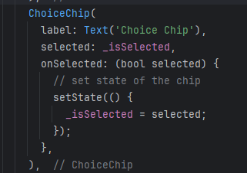
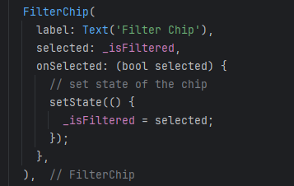
ChoiceChip and FilterChip

Slide 6
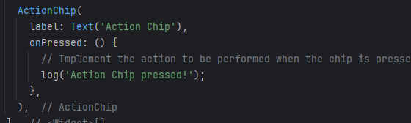
ActionChip
An actionChip is pretty much a button but looks like a chip.
  onPressed: call a method to do something

Slide 7
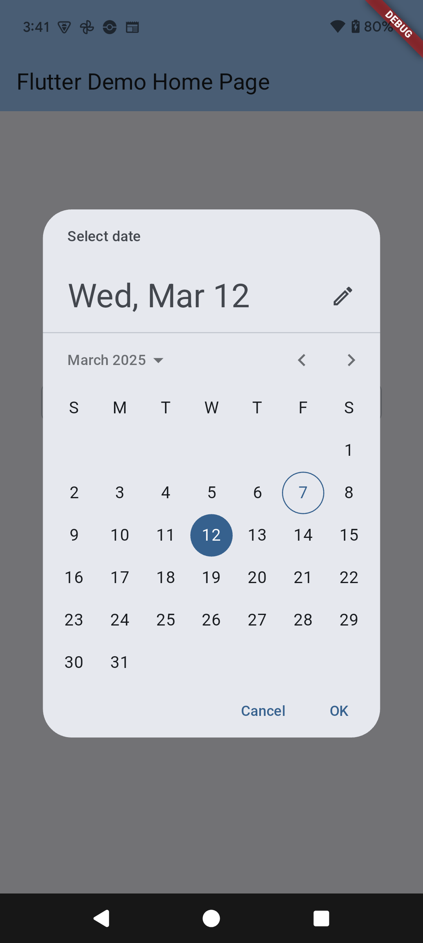
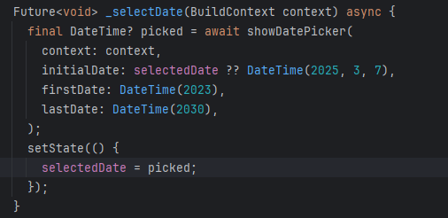
DatePicker
There is a built-in widget for a date Picker
  it's a future (ie separate thread), so we use the await until the user picks a date.

Slide 8
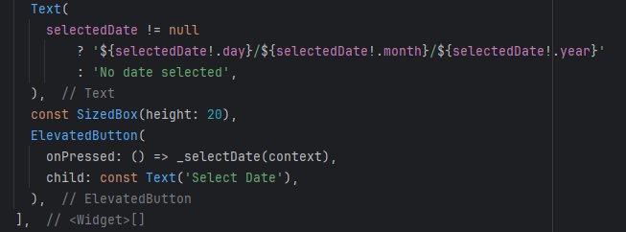
DatePicker (2)
launching via a method
and using the setState to display it in the app.

Slide 9
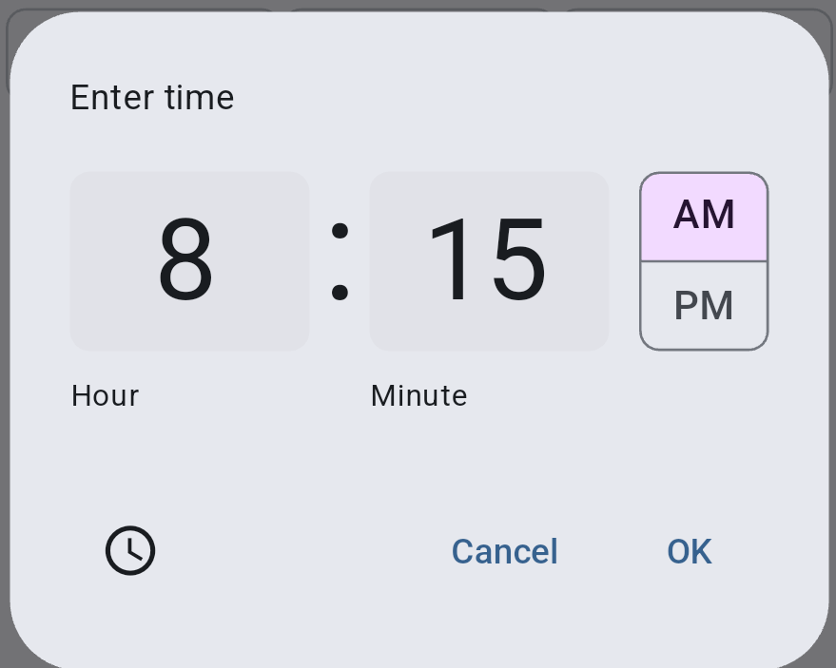
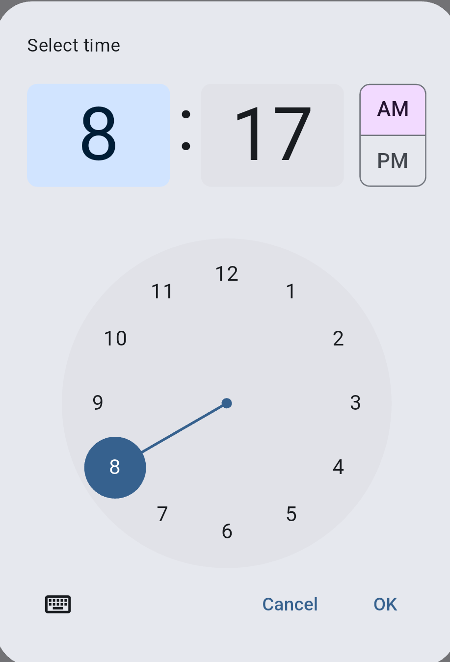
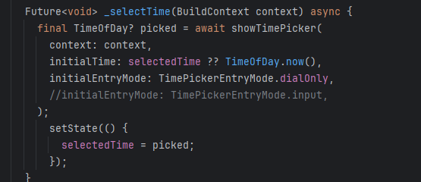
timepicker
The time picker allows you to choose input or a dail
  The dialonly appears to be currently broken. Shows input and dial anyway.

Slide 10
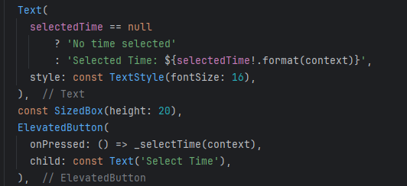
timepicker (2)
again, launching via a method
and using the setState to display it in the app.

Slide 11
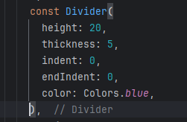
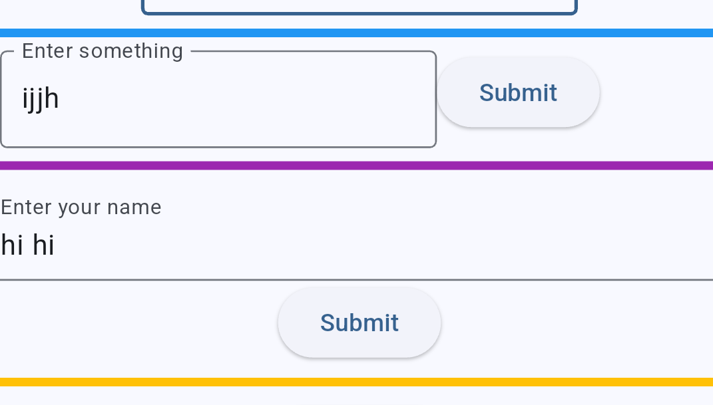
Divider
A quick way to put a "line" between to widgets

Slide 12
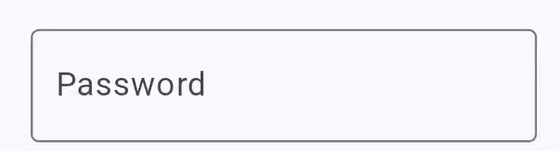

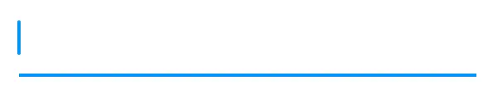
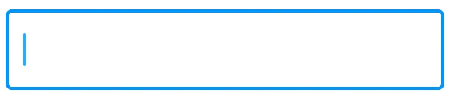
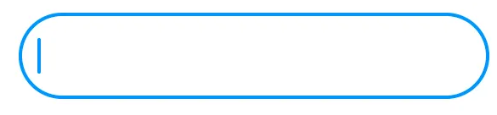
TextField and InputDecoration
TextField has
ObscuredText: true
  used for things like passwords.
Decoration:
  normally use InputDecoration(
  border: InputBorder.none,
  border: UnderlineInputBorder(),
  border: OutlineInputBorder(),
  borderRadius: BorderRadius.circular(30),
  or create custom.

Slide 13
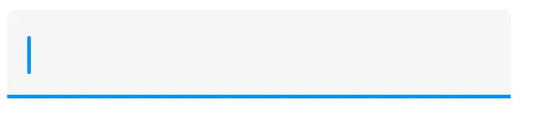
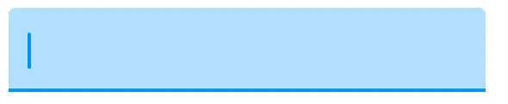
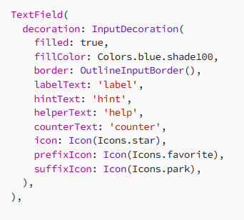
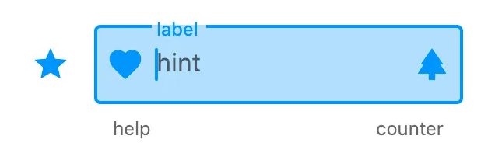
TextField and InputDecoration (2)
inputDecoration
  Filled: true
  Filled: true
  fillColor: Colors.blue.shade100

Slide 14
input validation. TextField vs TextFormField
TextField is the most commonly used text input widget.
TextFormField wraps a TextField and integrates it with the enclosing Form. This provides additional functionality, such as validation and integration with other FormField widgets.

Slide 15
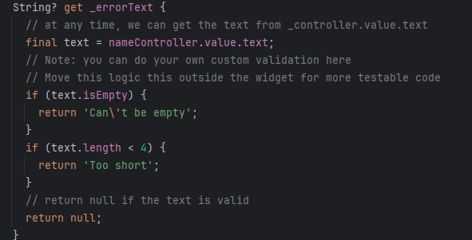
TextField with validation
With a controller for textField, nameController and validation function
can't be empty
longer 4 characters

Slide 16
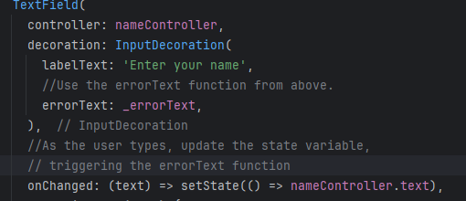
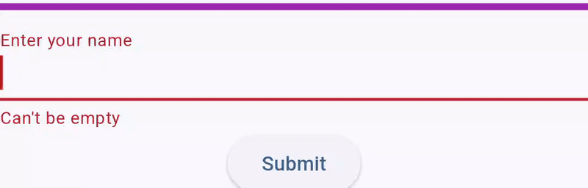
TextField with validation (2)
The function is called by the setState() method for each character that user types, so errorText: changed as needed.

Slide 17
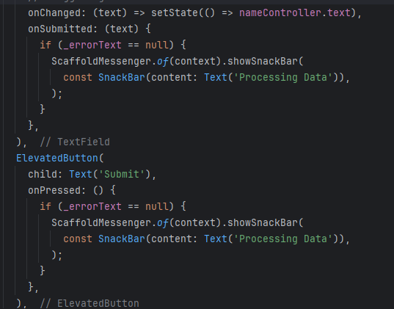
TextField with validation (3)
lastly, check error, when the submit button is pressed or the enter key is pressed on the keyboard.
in this, just a snackbar is called.

Slide 18
TextFormField with Validation
We need a globalKey to trigger states for the form, but don't necessary needs controller. this example does use one.
final _formKey = GlobalKey<FormState>();
A textFormField is also a form, which is what the key is used for.

Slide 19
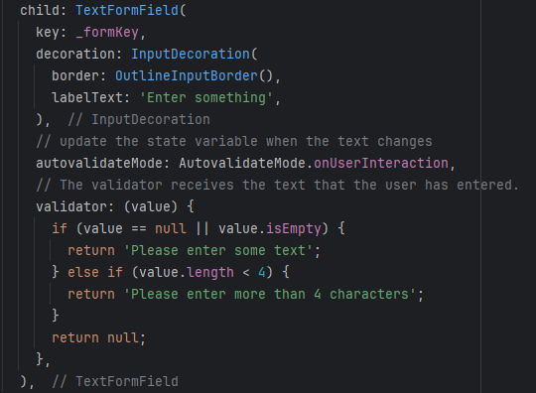
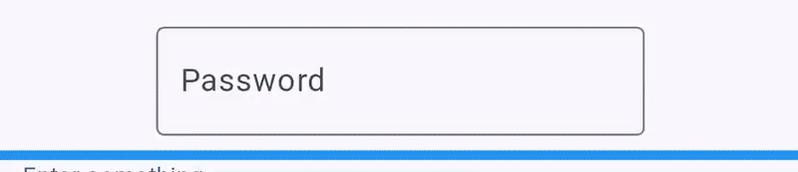
TextFormField with Validation (2)
using the validator, instead errortext
and autovalidateMode .onUserInteraction

Slide 20
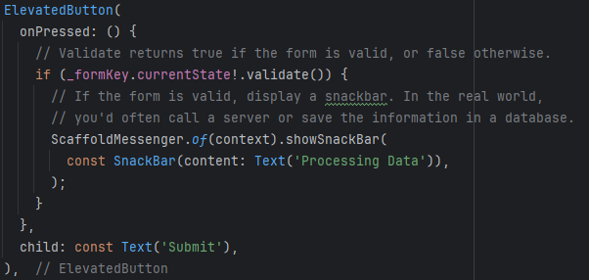
TextFormField with Validation (2)
like textField, we call the validate to verify.
We could in validate disable the button. OnSubmit would work though

Slide 21
menu

Slide 22
menu with MenuAnchor
A note, there full change between material design 2 and material design 3.
  PopupMenuButton is M2 Lots of examples and documentation
    copilot keep trying to use it as well. Material 2 components are "depreciated".
  MenuAnchor is M3, not as many example, documentation is bit hard to follow.
A note, Menu's don't need to be in the top bar and a popup menu can be anchor'd to any widget.
https://api.flutter.dev/flutter/material/MenuAnchor-class.html

Slide 23
menuAnchor
A menuAnchor has 2 required pieces
  menuChildren: These would be items in the menu
  builder: Which builds the menu and provides the iconButton or TextButton.
  OR
  child: which is the widget you want to anchor the popupMenu too.
    but you need a trigger for the menu, like gesture detector.

Slide 24

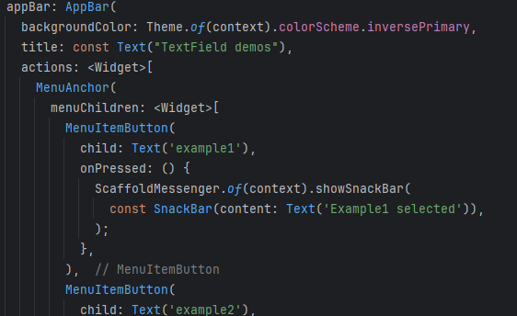
menu on the app bar.
in AppBar() use the actions: <Widget>[ here ]

Slide 25
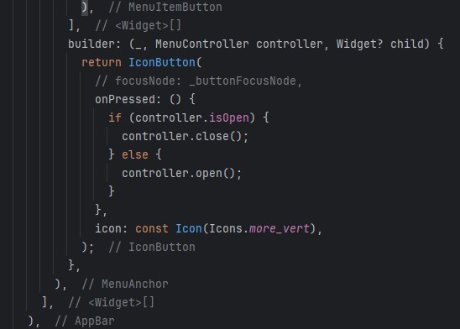
menu on the app bar (2)
once you have all the menuItemButton,

Slide 26
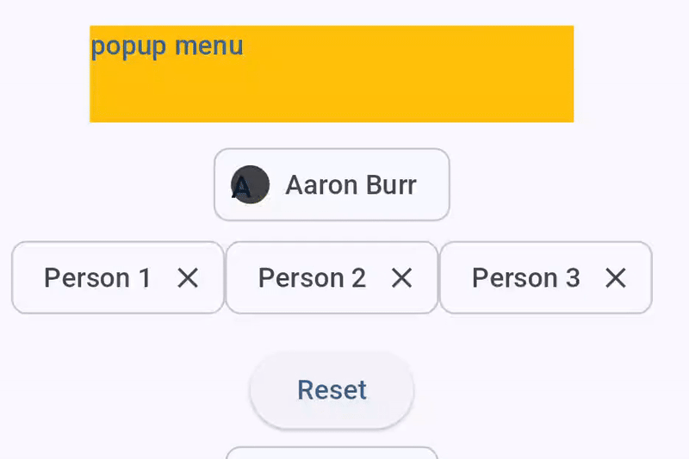
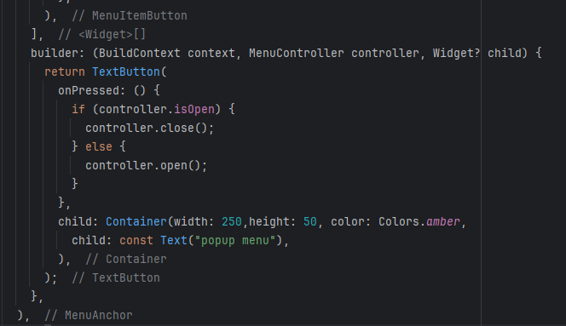
From "textButton"
Same idea for the MenuAnchor and menuItemButton, builder:
but I'm providing a container that is yellow,
it doesn't show a button.

Slide 27
icon badges

Slide 28
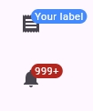
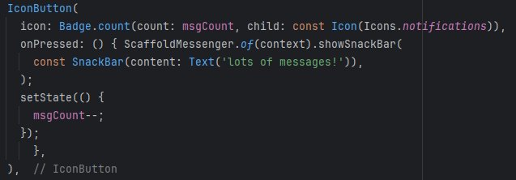
Badges
Any icon can take on a badge.
  A badge is just a number or text that shows above the icon itself.
  any navigation pieces that use icons or any place you want an icon.
For a number, use badge.count in the icon:
  the badge then provides the icon to it.

Slide 29
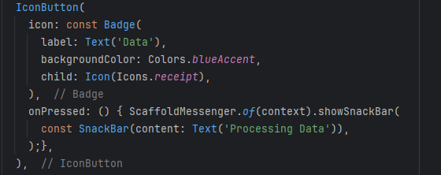
For icon Text badge
you need to provide label, backgroundColor is optional but recommended.

Slide 30
References
https://flutter.dev/docs/codelabs
https://api.flutter.dev/flutter/material/showDatePicker.html
https://api.flutter.dev/flutter/material/showTimePicker.html
https://api.flutter.dev/flutter/material/Chip-class.html
https://medium.com/@paghadalsneh/a-visual-guide-to-input-decorations-for-flutter-textfield-6f805d1991b7
https://codewithandrea.com/articles/flutter-text-field-form-validation/
https://api.flutter.dev/flutter/material/TextField-class.html
https://api.flutter.dev/flutter/material/Badge-class.html

Slide 31
Q
A
&

