Slide 1
cosc 4735
google maps and ads

Slide 2
Google Ads

Slide 3
Monetization features
Google Mobile Ads SDK for Flutter
  It supports a variety of ads formats such as app open, banner, interstitial, native, rewarded, and rewarded interstitial formats, and features like mediation.
The Integrated Media Ads SDK for Flutter
  The Interactive Media Ads SDK for Flutter empowers both app developers and publishers to seamlessly integrate video ads into their video content. With support for pre-roll, mid-roll, and post-roll ad placements on both iOS and Android, the plugin offers a comprehensive solution for instream video ad monetization.
Adsense for H5 games (closed beta)
  Flutter’s AdSense for H5 games plugin allows you to easily add AdSense interstitial and rewarded ads to your web-based (H5) games built in Flutter

Slide 4
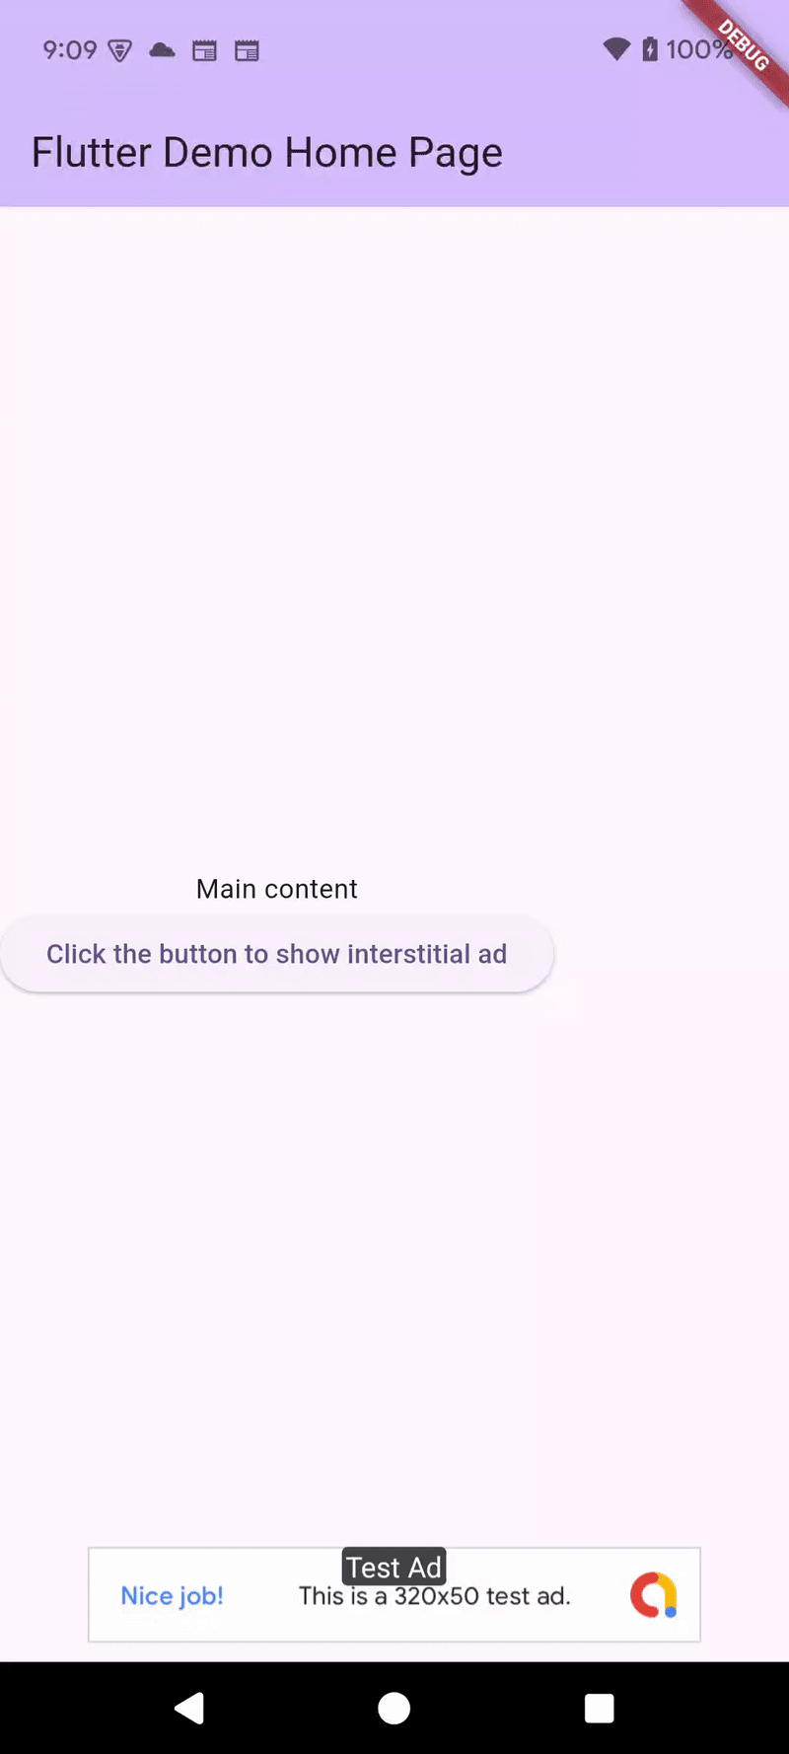
Monetization features (2)
There are many that offer ads, but for this we will just stick with google.
  Also, I was struggling to find documentation for other ads services using flutter. (Apr 2025)
Google says it works on android, iOS, and web
  But it doesn't work on the web, maybe adsense does, but closed beta.

Slide 5
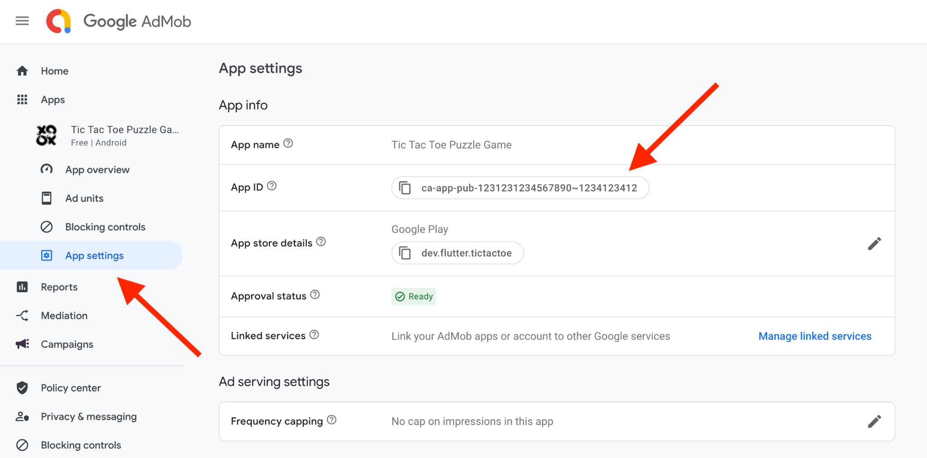
AdMob
First you need to sign up with AdMob, google's advertising platform. https://admob.google.com/home/
You also need the app id and ad unit ids

Slide 6
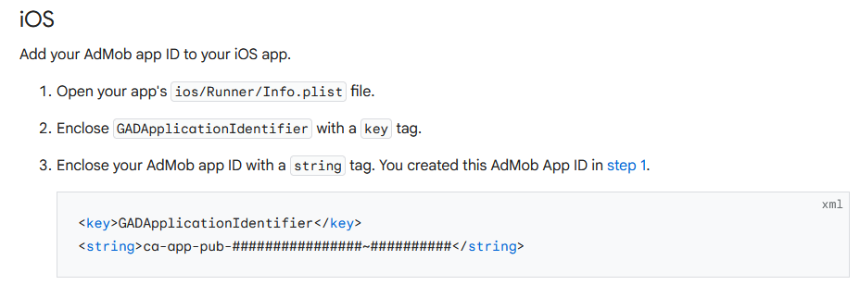
iOS setup

Slide 7
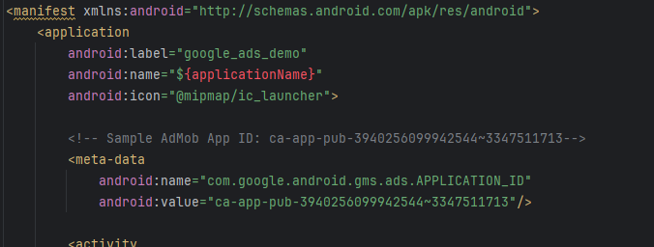
Android setup
in the android->app->src->main-> androidManifest.xml file
  add your app id (I'm using a Google's test ID)

Slide 8
add plugin.
add google_mobile_ads plugin
  flutter pub add google_mobile_ads
There was note from google, that android maybe need to add FlutterMultiDexApplication.java to android project and to say yes.
  I didn't get this message compiled.
Note this is using the flutter/google_ads_demo

Slide 9
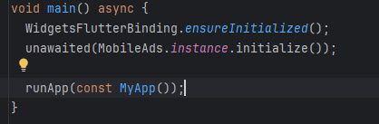
initialize
in the main,
Note, the unawait()
  MobileAds.instance.initialize() returns a Future but, the way the SDK is built, you don't need to await it. If you try to load an ad before that Future is completed, the SDK will gracefully wait until the initialization, and then load the ad.

Slide 10
ads
for each different ad placement you want, you need an AD Unit ID
For this example, we have 2.
  A banner add at the bottom of the main widget
  and Interstitial Ad
    an ad that normally shows between sceens.
  Each uses a different ad ID, which you set up in the console under Ad Units menu in the console.
  For this example, I'm using Google's test IDs.
    we will only show test ads.
Please note, Google is very specific that clicking your own ads is against policy and you account can be removed for it.

Slide 11
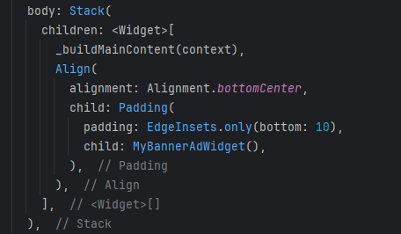
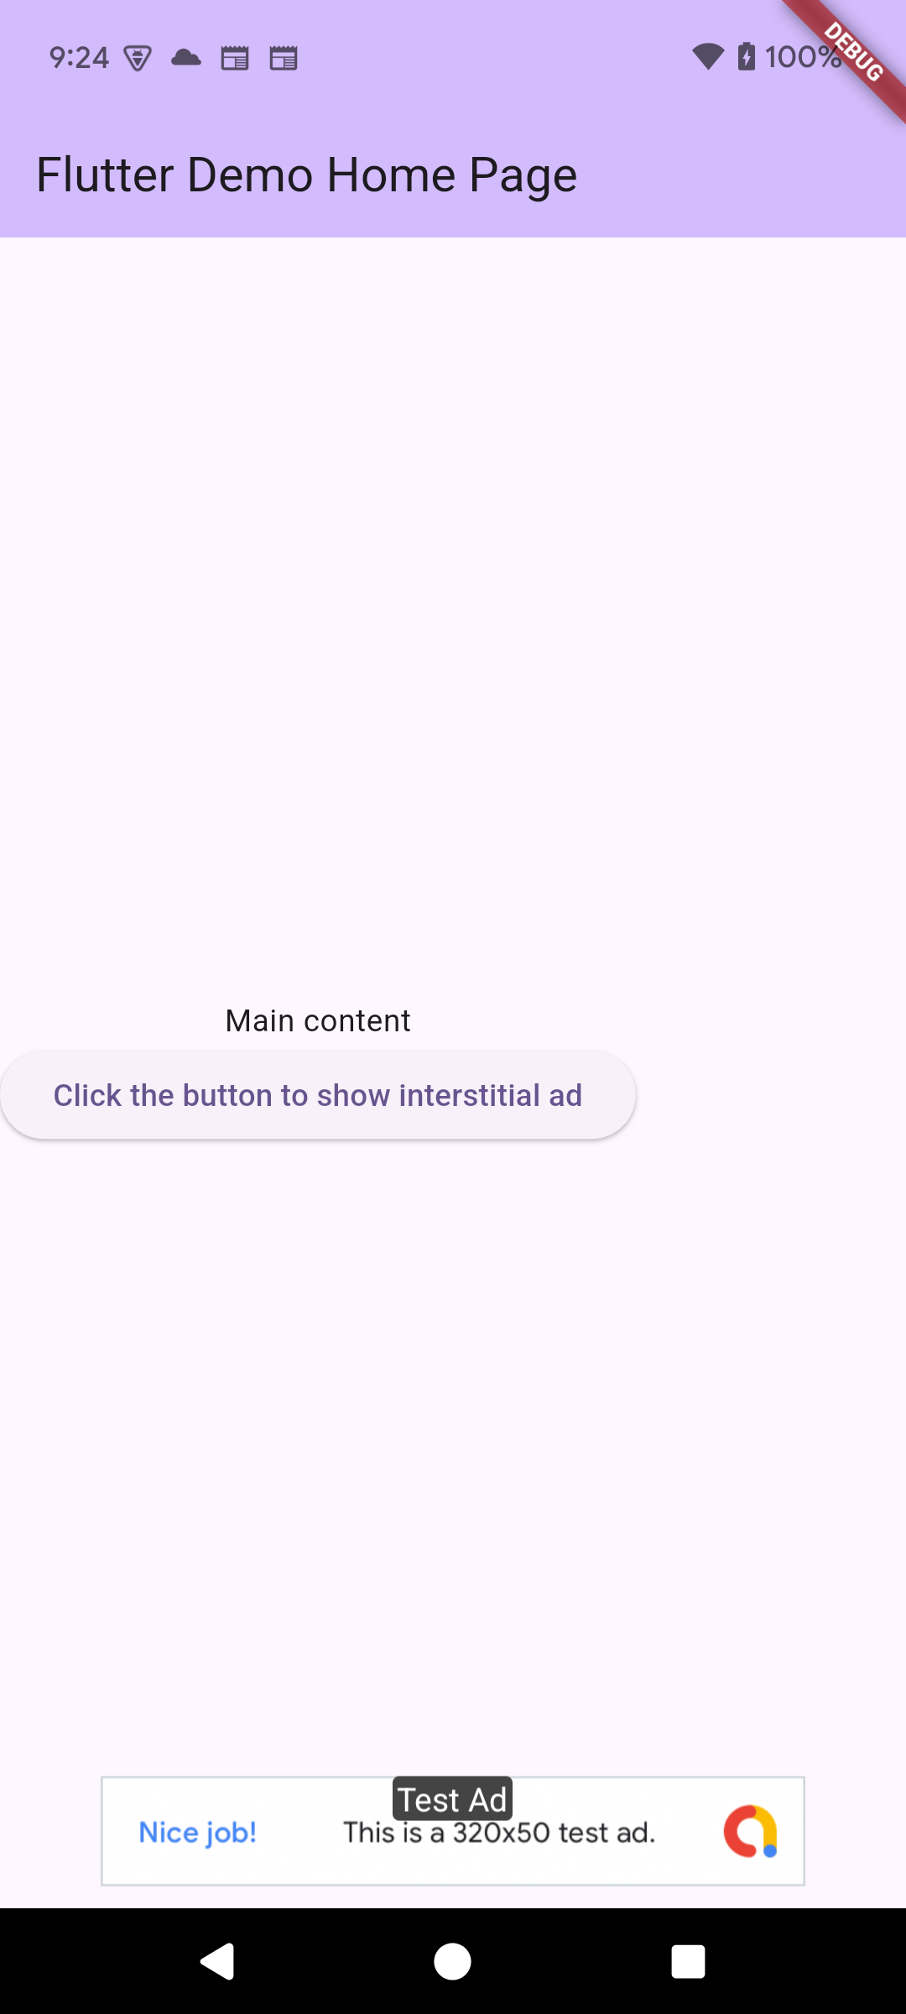
Banner ads
The flutter example google uses is bit complex, but we need to return a widget and then show it on the screen.
  Since I wanted a banner ad at the bottom of my screen. The main code looks like this:
  _buildMainContent is just my function name to build the main widgets of the app. MyBannerAdWidget is the ad itself.

Slide 12
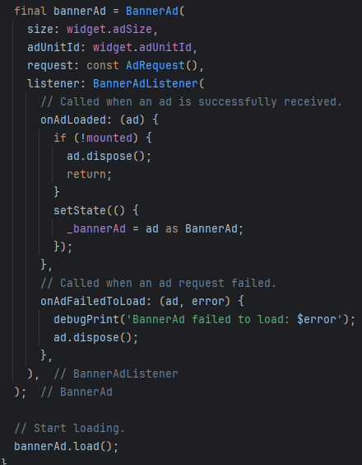
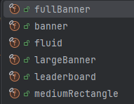
Banner ads
It's easy to look code in project, but this main piece that loads the ads
  adUnitID is the id number
  adSize is the size of ad

Slide 13
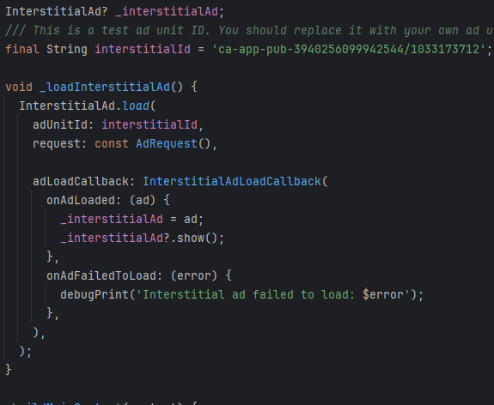
Interstitial Ads
these are easier, because they take the whole screen.
When the user closes the ad, then it returns to "main" widget again.

Slide 14
References
https://docs.flutter.dev/cookbook/plugins/google-mobile-ads
https://admob.google.com/home/
https://flutter.dev/monetization

Slide 15
Googe Maps
based on a code lab.

Slide 16
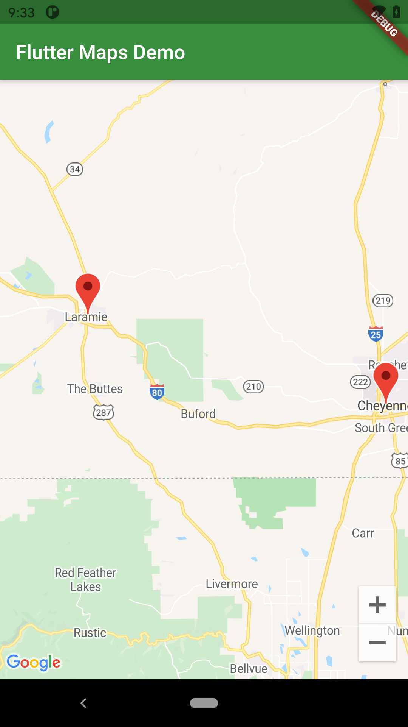
Google Maps.
This is very similar to how ads was done.
we need to get a map key for android and iOS
  add it to the correct files
add the plugin
flutter pub add google_maps_flutter

Slide 17
keys.
add a key to
  android: android/app/src/main/AndroidManifest.xml
  iOS: ios/Runner/AppDelegate.swift
  web: web/index.html
See the codelab for all the right spots in the files.
  https://codelabs.developers.google.com/codelabs/google-maps-in-flutter#0, item 4.

Slide 18
Get the map.
In a stateful widget, but like android part of the map is coming via a thread (async)
you need a couple of pieces.
  the controller
  googleMap in the body.
a simple version
For markers set this
Future<void> _onMapCreated(GoogleMapController controller) async {
mapController = controller;
}
@override
Widget build(BuildContext context) {
return MaterialApp(
home: Scaffold(
appBar: AppBar(
title: const Text('Flutter Maps Demo'),
backgroundColor: Colors.green[700],
),
body: GoogleMap(
onMapCreated: _onMapCreated,
initialCameraPosition: const CameraPosition(
target: LARAMIE,
zoom: 11.0,
),
markers: _markers.values.toSet(),
),
),
);
}

Slide 19
markers
To add markers to your map.
in the build GoogleMap
markers: List of markers.
then use the setState to add new markers.
final Map<String, Marker> _markers = {};
Future<void> _onMapCreated(GoogleMapController controller) async {
mapController = controller;
setState(() {
_markers.clear();
Marker laramieMarker = const Marker(
markerId: MarkerId("Laramie"),
position: LARAMIE,
infoWindow:
InfoWindow(title: "Laramie", snippet: "home of UW"));
_markers["Laramie"] = laramieMarker;
});
}

Slide 20
More and Examples
flutter_mapdemo give you the maps
  remember you need your own key to get it to work.
We program to onTap and onLongPress
what happens when you click on markers
moving the camera and layers.
plus, we draw on the maps as well with polygons and kml information.

Slide 21
More
we also have
MapEvents:
  Tap, LongPress, doubleTap, drag, keyboard, scrollWheel
MapController
  moves (lat,long), rotate, mapCamera (view/size/zoom)
Drawing which includes OverlayImageLayer, Polygon, Polyline
Hadrien Lejard's google_maps_webservice package which makes the Google Maps Web Services, like Directions API (legacy), Distance Matrix API(legacy), and Places API really easy to use.

Slide 22
References
https://codelabs.developers.google.com/codelabs/google-maps-in-flutter#0
https://pub.dev/packages/flutter_map

Slide 23
Q
A
&

