Slide 1
cosc 2030
STL, java, and python:
hashing and sorting

Slide 2
hashing
unordered_set
  containers that store unique elements in no particular order, and which allow for fast retrieval of individual elements based on their value.
    Note can't be changed (since it would changed the hash value), but can be inserted and removed
  organized into buckets, which allows for fast access (constant time)
unordered_map
  uses a pair, where the first is the key.
  like a set, there is no order and it very fast.
  second value can be changed (not the key) and can use []
both unordered set and map are faster then their ordered versions
  but less efficient using the iterators for range operations.

Slide 3
unordered_set example
#include <unordered_set>
#include <iostream>
using namespace std;
unordered_set<std::string> mySet;
Insert strings to the set
mySet.insert("First");
mySet.insert("second");
mySet.insert("third");
remove an item
mySet.erase("second");
find operation
if (mySet.find("fourth") == mySet.end() )
cout <<"fourth key not found\n";
else
cout <<"fourth key was found.
we can iterate over it as
for (string s: mySet)
cout <<s<<endl;

Slide 4
unordered_map example
#include <iostream>
#include <unordered_map>
using namespace std;
unordered_map<string, int> myMap;
Insert strings to the set
myMap.["First"] =10;
myMap.["second"] = 20;
myMap.insert(make_pair("third", 30));
find
if (myMap.find("third") == myMap.end() )
//not found
else
//found
interating over all.
unordered_map<string, int>:: iterator itr;
cout << "\nAll Elements : \n";
for (itr = myMap.begin(); itr != umap.end(); itr++) {
cout << itr->first << " " << itr->second << endl;
}
}

Slide 5
sorting
#include<algorithm> has a sort function built in.
  Some STL a built in as well.
sorting an array
int arr[5] = {1,5,8,4,2};
sort(arr , arr+5); //sort the whole list, could only sort part of the list.
So sort a vector
vector<int> v{ 1, 5, 8, 9, 6, 7, 3, 4, 2, 0 };
sort(v.begin(), v.end());

Slide 6
sorting (2)
Say you want to sort descending, instead of ascending.
  you need to pass it a "comparator" function or struct.
function
  bool myfun (int a, int b) { return (a>b); } //a<b is ascending.
struct
struct myobj {
bool operator() (int a, int b) { return (a>b); } //a<b is ascending.
} ;
call sort
sort(arr , arr+5, myfun);
OR
sort(arr , arr+5, myobj);

Slide 7
sorting (3)
is_sorted( ) will return true or false if the list (or sublist) is sorted
  Also can take function or struct.
int arr[5] = {1,5,8,4,2};
if(is_sorted(arr , arr+5)) {
//true, it's a sort list.
}

Slide 8
STL::Sort()
The algorithm used by sort() is IntroSort.
Introsort being a hybrid sorting algorithm uses three sorting algorithm to minimize the running time, Quicksort, Heapsort and Insertion Sort.
  Introsort begins with quicksort and if the recursion depth goes more than a particular limit it switches to Heapsort to avoid Quicksort’s worse case time complexity.
  It also uses insertion sort when the number of elements to sort is smaller.

Slide 9
qsort()
qsort is actually a c function, instead of c++
#include <stdlib.h> or <cstdlib>
requires a comparator and because it's c, it's has this form
  int compar (const void* p1, const void* p2);
  return neg if less, 0 if ==, pos if greater
int compare(const void * a, const void * b) {
return ( *(int*)a - *(int*)b );
}
then call qsort( arr, size of array, data size, compar)
qsort(arr, 5, sizeof(int), compare);
Note: sort is probably faster.

Slide 10
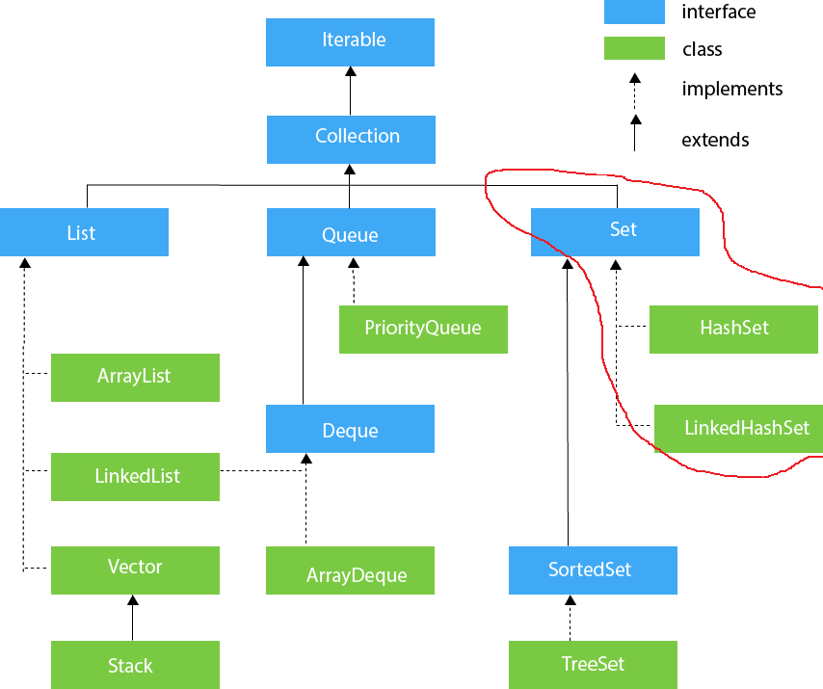
Java Hashing
The last part of the collection Set is the HashSet, HashMap, and LinkedHashSet

Slide 11
HashSet
unique elements only. Like the TreeSet
null is allowed as a value, once (see above)
HashSet doesn't maintain insertion order.
  this should not surprise you.
it's not thread safe
Initial capacity of hashSet is 16 and the load factor is set to .75
methods:
  add (object), clear(), contains( object), isEmpty(), remove( object), size()
  HashSet( capacity) as constructor can change the initial capacity.
  HashSet(int capacity, float loadFactor) to change capacity and load factor setting.

Slide 12
HashSet Code
HashSet<String> hash=new HashSet();
hash.add("One");
hash.add("Two");
hash.contains("Two"); //returns true

Slide 13
LinkedHashSet
it's an linkedlist implementation of HashSet.
everything is the same from a HashSet, except it maintains insertion order.
  it requires a lot of extra memory and is much slower, so if you don't need order maintained, then don't use this.
Otherwise, there is no change to methods and code exception declaration
  LinkedHashSet<String> Hash=new LinkedHashSet();

Slide 14
HashMap
hashMap is the same as hashSet but using a MapEntry<key,value>
the keys must be unique and only one key can be null. values can be null as needed.
methods
  put(Key, value), putAll(mapEntry), remove(key), containKey(key), containsValue (value)
  HashMap<Integer,String> map=new HashMap<Integer,String>();
  map.put(1,"Jim");
there is a LinkedHashMap as well, same idea as a hashmap and linked list.

Slide 15
Java Sorting
building sorting for arrays
int[] arr = { 5, -2, 23, 7, 87, -42, 509 };
Arrays.sort(arr); //now the array is sorted ascending.
Arrays.sort(arr, Collections.reverseOrder()); //sort in descending oder
the Java Documentation says it uses a dual-pivot Quicksort on native objects
  it uses mergesort of Arrays of objects.
if you want to sort an Array in parallel (as of Java v8)
  Arrays.parallelSort(arr);
  same as sort, but now uses multi-threading.

Slide 16
Java Sorting (2)
Collections, any List implementations
  List<Integer> listArr = Ints.asList(toSort);
  Collections.sort(toSortList);
Uses mergesort.
You can sort Sets and Maps (ie HashSet, TreeSet, LinkedX, and HashMap and TreeMap)
  but why???
  the Linked makes even less sense, since insertion order is importanted.

Slide 17
Java Sorting (3)
To sort you own custom classes
you need to have a int CompareTo( object) method
  1 is bigger, 0 equal, -1 smaller.
As note, Java collections also has a shuffle method which will reorder the list "randomly".
  Collections.shuffle(list);

Slide 18
hash data structures in other languages
Many languages have built in support for hashing.
  commonly called Dictionary or associative array

Slide 19
python
it's called a dictionary
implementation:
  below shows the hash function
  collisions are handled with open addressing
    quadratic probing.
  https://www.laurentluce.com/posts/python-dictionary-implementation/

Slide 20
python dictionary
dict = {"Flintstone": "fred"};
dict["Rubble"] = "barney";
x = dict.get("Rubble"); //x = barney
if "Flintstone" in dict:
print ("Flintstone ", dict.get("Flintstone") );
dict.pop("Rubble"); //removes the item.
print (len(dict)); //how many entries.

Slide 21
python sort
lists have a built-in sort method
cars = ['Ford', 'BMW', 'Volvo']
cars.sort() //ascending by default
cars.sort(reverse=True) //descending sort.
It uses the Timsort method since v2.3
  which is a hybrid of merge sort and insert sort
  https://en.wikipedia.org/wiki/Timsort

Slide 22
Q
A
&

