Slide 1
Cosc 2030
Recursion

Slide 2
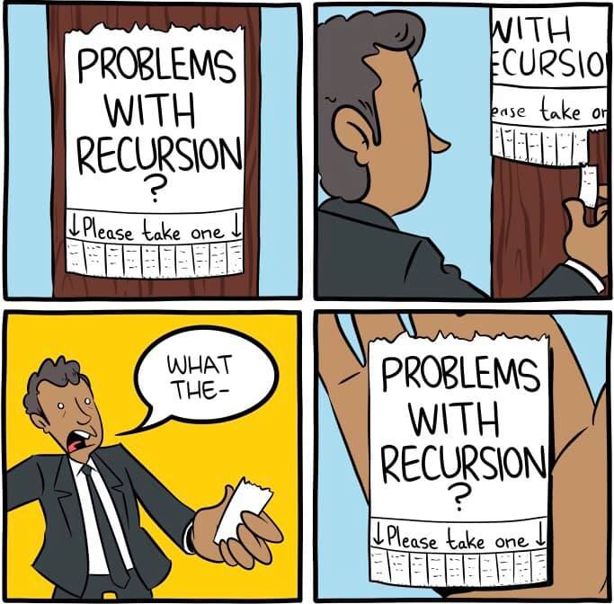

Recursion
Recursion is a function call to the same function calling it.

Slide 3
Recursion
Recursion is a function call to the same function calling it.
It's pretty common in math formulas
The Fibonacci sequence is a good example of it
  F_{n} = F_{n-1} + F_{n-2}
    Where F1 =1, and F2=1
1, 1, 2, 3, 5, 8, 13, 21, 34, ...
int fib(int f) {
if (f ==1) {
return 1;
} else if (f ==2) {
return 1;
} else {
return fib(f-1) + fib(f-2);
}

Slide 4
Fibonacci sequence starting with 5
Fib(5)
fib(4)
fib(3)
fib(2)
fib(2)
fib(1)
fib(2)
fib(3)
fib(1)

Slide 5
Fibonacci sequence starting with 6
fib(6)
Fib(5)
fib(4)
fib(4)
fib(3)
fib(2)
fib(1)
fib(2)
fib(3)
fib(2)
fib(1)
fib(3)
fib(2)
fib(1)
fib(2)

Slide 6
Types of recursion
Linear Recursion
  The function makes a single call to itself each time.
Tail Recursion
  Linear recursion, but the call is at at the end of function.
    Normally can be rewritten without recursion as well.
Binary Recursion
  Has two recursive calls
    Like Fibonacci sequence
Exponential recursion
  if you were to draw out a representation of all the function calls, would have an exponential number of calls in relation to the size of the data set
Nested Recursion
  One of the arguments to the recursive function is a recursive call to itself.
Mutual Recursion
  Two or more functions are call each other.
    A calls B
    B calls A

Slide 7
Linear recursion
Let's print a string backward using recursion
This is pretty simple without recursion
  using a loop, start at the end and work backward.
void prt_backward(string text) {
int length = text.size();
if (length >0 ) {
//now send the rest of the string
prt_backward(text.substr(1,length));
//print our character.
cout <<text.at(0);
}
}

Slide 8
progression of prt_backward with "cat"
received "cat"
received "at"
received "t"
print t
called "at"
called "t"
received ""
empty return
called ""
print a
print c

Slide 9
Question
void prt_backward(string text) {
int length = text.size();
if (length >0 ) {
//print our character.
cout <<text.at(0);
//now send the rest of the string
prt_backward(text.substr(1,length));
}
}
What the output of the code called with "cat"?

Slide 10
data structure: an array
an array a simple data structure and when combined with recursion
  Arrays can be a practical and powerful data structure.
a major class of recursive algorithms are called "Divide and Conquer"
  Each recursive call divides the data into a smaller section and then deals with it.

Slide 11
Search
Say we need to search the data for answers
example is a piece of data in the data set?
  spelling for example, is the word in a dictionary?
What the max or min of the data?
There are a number of search based queries.

Slide 12
Question: the Data?
So let assume we read a long list of integers into an array.
What is the order of the data?
  Is it sorted or unordered?

Slide 13
Binary search
If the data is sorted, then we use a binary search of an array.
  each level of recursion will cut the search space of the data in half
  it leads to one spot where the data should exist.
binarySearch(array, target)
if array is of size 1
return is array equal to target
else
find midpoint of array
if (is target in first half of the array)
binarySearch(first half of the array, target)
else
binarySearch(second half of the array, target)

Slide 14
binary search implementation
First to save memory space, we are not going to send smaller and smaller array, instead we are going to send array indexes
second we will return the index of value if found, or -1 if not found.
int binarySearch(int anArray[], int first, int last, int target)
array size of 1 is a simple
if (first == last)
determine the mid point is now trivial
int mid = (first + last) /2;
which half
if (target < anArray[mid])
and first/second half is easy as well.
binarySearch(anArray, first, mid-1, target) //first half
binarySearch(anArray, mid, target) //second half

Slide 15
efficiency issue.
What is the mid point on the first call has the target value?
  in an array of say 100, and the target is at 50.
    We would call with size of 100, then 50, then 25, then 13, then 7, 4, 2, 1
    8 unnecessary calls.
Let's change the base case to 2 cases
1 if the anArray is empty
  changes second call to binarySearch(anArray, mid+1, target)
2 if the anArray[mid] == target

Slide 16
efficient version
int binarySearch(int anArray[], int first, int last, int target) {
if (first > last)
return -1; //target is not in the array.
else {
int mid = (first + last) /2 ;
if (target == anArray[mid])
return mid; //found the target
else if (target < anArray[mid])
return binarySearch(anArray, first, mid-1, target); //first half
else
return binarySearch(anArray, mid+1, last, target); //second half
}
}

Slide 17
examples array is {1,5,9,12,15,21,29,31}
search for 9 (successful)
search for 22 (unsuccessful)
target =9 first=0 last=7 mid=3
target < anArray[3]
target =9 first=0 last=2 mid=1
target > anArray[1]
target =9 first=2 last=2 mid=2
target = anArray[2] return 2
target =22 first=0 last=7 mid=3
target > anArray[3]
target =22 first=4 last=7 mid=5
target > anArray[5]
target =22 first=6 last=7 mid=6
target < anArray[6]
target =22 first=6 last=5
first > last return -1

Slide 18
finding the largest value
Sorted array
  trivial. It's at the end of the array (assuming ascending sort)
unsorted array
  you could construct an iterative solution that goes through the array searching for the largest value.
  you could also construct a recursive version using divide and conquer method.
    It would be binary recursion, since we need to search both directions.
      unlike binary search where we searched in only one direction.

Slide 19
code for a finding largest value.
int maxValue(int anArray[], int first, int last) {
if (first == last) {
return anArray[first]; //only element, so it must be the max.
} else {
int mid = (first + last) /2 ;
return max(//max of the two return values.
maxValue(anArray, first, mid),
maxValue(anArray, mid+1, last )); }
}

Slide 20
example using anArray ={1,6,8,3}
first=0, last=3, mid =1
first=0, last=1, mid=0
first=0, last=0
first=1, last=1
first=2, last=3, mid=2
first=2, last=2
first=3, last =3
Will this structure change for 4 items?

Slide 21
Question
Will the recursive method work for a sorted list?

Slide 22
Question (2)
Data can drive the solution.
in find the max value, if you always know the array was sorted
  no search, it get the value.
Question?
  Should we sort the data first then?
    This is a question of efficiently and speed.
      Is it faster to sort the data and then pick or just find the value?
    One we can answer generally by the end of the course and cosc 3020 can answer formally.

Slide 23
Q
A
&

