Slide 1
COSC 2030
C++ primer

Slide 2
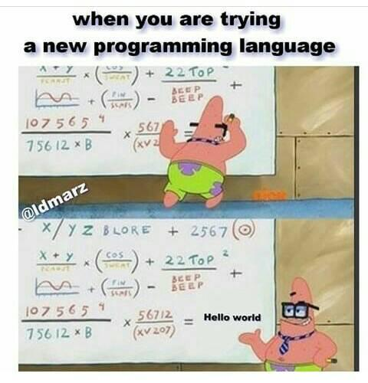

Slide 3
C++ primer
there are many resources and places to look for tutorials and help.
  http://www.cplusplus.com/ is one of the better ones. Help can be found on stack overflow as well
    note, just "Cut and Paste code" and turning it in, is considered academic dishonesty. Plus it rarely works/compiles. Same for any of the LLMs.
At this point, I expect you to be able to use to
  Variables of types: char, int (short, long, and long long as needed), float, double, long double, and bool
    And simple arrays. ie: int a[5];
  Basic Input/output: cin, cout, cerr And file IO.
  Control statements:
    if, else, switch case,
    while, for with continue and break statements as well.
  Functions, return values, parameters (both call by reference and call by value)

Slide 4
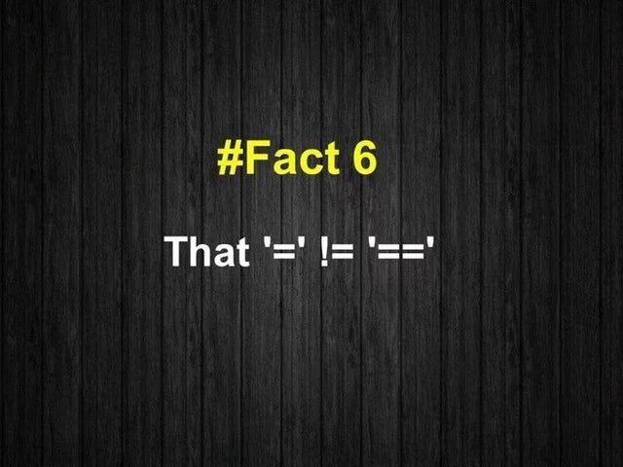

Slide 5
C++ a note about True and false
Bool can only take two values, 1 and 0
  true =1, false =0
BUT C++ uses more then bool for True/False
  0 is always false. Everything else (ie all non-zero numbers) is true.
  nullptr is false, NULL is false, because it evaluates to zero.
    A note, NULL doesn't compile in c++ anymore. It is included in c libraries.
  if (a=5) is true, because it returns 5.
  if (a=0) is false, because it returns 0.
  if ('y') is true, because the ascii code for y is 89.

Slide 6
loops
Bottom testing loops
Range-based loops in c++11 standard
int i=0;
do {
cout << "[" << i << "]";
i++;
} while (i>5);
cout << '\n';
OUTPUT:
[0]
string str {"Hello!"};
for (char c : str) {
cout << "[" << c << "]";
}
cout << '\n';
OUTPUT:
[H][e][l][l][o][!]

Slide 7
classes
Remember how to declare classes
Public vs private
How to declare inline functions
How to declare functions with scope.
Constructors and Destructors
  We use the new operator to get memory, then we must ALWAYS delete it later
  The destructors can take care of it for us.
Class name {
int x, y; //private
Public:
int z; //public
void set(width) { x=width;}
int getWidth() {return x;}
void setY(int); //declaration only
};
void name::setY(int height) {
y = height;
}

Slide 8
Inheritance and Class Hierarchies
Object-oriented programming (OOP) is popular because:
  It enables reuse of previous code saved as classes
Inheritance and hierarchical organization capture idea:
  One thing is a refinement or extension of another

Slide 9
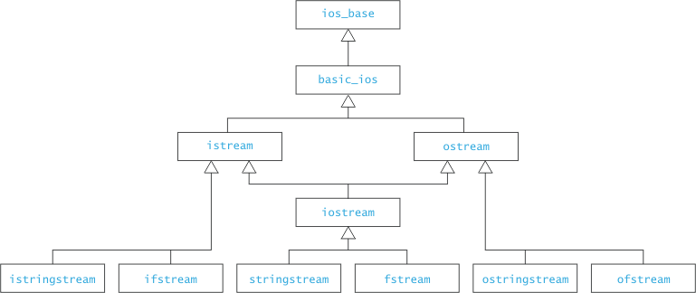
Inheritance and Class Hierarchies (2)
base class
or
superclass
derived class
or
subclass

Slide 10
Base and Derived classes
The Base class is a normal class.
  May use the term protected
    Allows the derived class to access the data from the base class, but data is not public.
The Derived class uses the base class and
  Class derived-class : public base-class { … }
  It then adds methods and data as needed.
  Can access public and protected methods and data
  Can then overload methods to change the functionality of the method.
    Using base-class::method-name allows class access base class functions that have been overloaded.

Slide 11
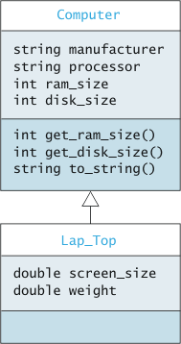
Example
Consider two classes: Computer and Laptop
A laptop is a kind of computer: therefore a derived class
methods of Computer and all derived classes
variables of Computer and all derived classes
additional variables for class Laptop
(and its derived classes)
additional Methods for class Laptop
(and its derived classes)

Slide 12
Method Overriding
If a base class declares a member function to be virtual
And if derived class has a member function with the same signature
Then that member function overrides the superclass method:
class A { ...
public:
virtual int M (float f, string& s) { bodyA }
}
public class B :public A { ...
public:
int M (float f, string& s) { bodyB }
}
If we call M on an instance of B (or derived class of B), bodyB runs
In B we can access bodyA with: A::M(...)
The derived M must have same return type as base M

Slide 13
Polymorphism
Pointer of base class type can point to object of derived class type
Polymorphism means “many forms” or “many shapes”
Polymorphism lets the C++ determine at run time which method to invoke
At compile time:
  C++ compiler cannot determine exact type of the object
  But it is known at run time
Compiler knows enough for safety: the attributes of the type
  Derived class guaranteed to obey

Slide 14
Interfaces vs Abstract Classes vs Concrete Classes
An abstract class can have:
  Abstract methods (no body)
  Concrete methods (with body)
  Data fields
Unlike a concrete class, an abstract class ...
  Cannot be instantiated
  Can declare abstract methods
    Which must be implemented in all concrete subclasses

Slide 15
Abstract Classes
Abstract classes cannot be instantiated
An abstract class can have constructors!
  Purpose: initialize data fields when a subclass object is created

Slide 16
Example of an Abstract Class
class Food {
public:
const std::string name;
double calories;
double get_calories () {
return calories;
}
protected:
Food (const std::string the_name, double the_calories):
name(the_name), calories(the_calories) { }
public:
virtual double percent_protein() = 0;
virtual double percent_fat() = 0;
virtual double percentCarbs() = 0;
}

Slide 17
Example of a Concrete Subclass
class Meat : public Food {
private:
const double prot_cal; ...;
public:
Meat (const std::string the_name, double the_prot_cal,
double the_fat_cal, double the_carb_cal):
Foot(name, the_prot_cal+the_fat_cal+the_carb_cal), proto_cal(the_proto_cal) ... {}
public double percentProtein () {
return 100.0 * (prot_cal / get_calories());
}
...;
}

Slide 18
Pointers
At the base, all variables point to a memory location.
  int num; num = 25;
    The variable num is stored somewhere in memory. In location 4021 for example.
We can get the memory location (address) of any variable using the Address-of operator (&).
  Int num_address = &num;
    So num_address would have the value of 4021
We can use the Dereference operator (*) on an address to get value.
  So cout << *num_address<<endl;
    Output would be 25

Slide 19
Pointers (2)
Declaring a pointer
  Int * myPointer;
Remember, there is a spot to hold the address. Right now, there is no address nor value of an integer.
Simple example
int *p1;
int num =10;
p1 = &num;
cout <<*p1<<endl; //output is 10
*p1 = 20;
cout <<num<<endl; //output is 20
Notes:
bob house.

Slide 20
Pointers (3)
pointers and dynamic allocation of memory.
  Uses the new operator to allocation memory
example
  int * num;
  num = new int;
  *num = 10;
  cout <<"num is "<<*num<<endl; //output is 10.

Slide 21
dangling pointers.
Remember to set your pointer to "points to nothing"
int * p1 = nullptr;
Now you can test if the pointer has allocated memory (or points to something)
if (p1 != nullptr)
//now you can do what ever is needed, since p1 points to something.
Note, in C it's NULL, in java it's null, and in C++ nullptr;
  You may see NULL in c++ code, but it is deprecated and DO NOT use it.

Slide 22
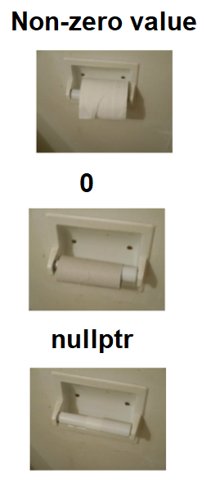
Pointer Values
nullptr points to nothing.
0 points to the zero position in the memory
Non-zero value points a memory location.

Slide 23
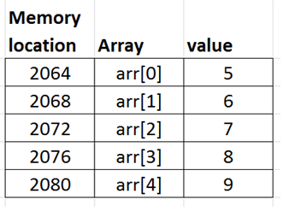
pointers and arrays
arrays are just pointers using [] operator to find the memory location
using the table
int arr[5] = {5,6,7,8,9};
arr actually points to location 2064
So when the code has arr[3]
  so math is done to find the location.
  basically the top of the array 2064 and add 3*4
    2064+12= 2076 is the address to use for arr[3]

Slide 24
pointers and arrays (2)
In the same way declared dynamic memory for a single variable, we can do that for arrays too.
int *arr;
arr = new int[5];
  Note arr now points to top/beginning of the array.
except, arrays use the[] operator instead of dereferencing
  arr[3] = 10; //works perfectly find.

Slide 25
final note about arrays and pointers.
since arrays are just pointers to the top of the array. we can do strange things to arrays.
  int arr[5];
  *arr = 10; //arr[0] =10;
  *(arr + 3) = 30 //arr[2] = 30; //compiler filled an overloaded + to d the math.
  arr++; //again overloaded ++ to do pointer arithmetic.
  *arr =20; //arr[1] =20. we moved the pointer to the next location.
  cout <<arr[0]<<endl; //actually looking at arr[1] location, so output is 20.
I'm not recommending you abuse arrays like this. I'm showing you arrays are just pointers.

Slide 26
new and delete
If at any point in your code you use dynamic memory, you MUST return it when you are done.
  You WILL lose points on homework/exams/programs if you forget.
new allocates memory
delete deallocates memory
*arr = new int[5];
*num = new int;
…
delete num;
delete [] arr; //note the [] are necessary to delete the whole array.

Slide 27
final note on pointers.
Almost every data structure you will write in this course
WILL USE POINTERS
We will come back and talk lot more about pointers in the first data structure linked lists.

Slide 28

Program Bugs.
The term bug comes from the old days of switch-based computers.
Millers and other insects were attracted to the heat of the computer and would get caught in the switches.
  Hence, there were bugs in the program, because the switches could not open and close correctly.

Slide 29
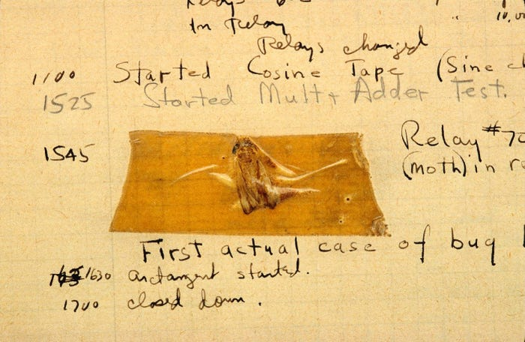

Slide 30
Types of defects
Syntax Errors
  Those are mostly caught by the compiler.
Logic Errors
  Hopefully found during testing
  The code does not perform correctly
Run-time Errors
  Lots of different types and some can happen, even with “perfect” code.

Slide 31
Run Time errors
Common Errors
  Division by Zero
    Divided by zero results in either positive or negative infinity.
  Out of bounds errors (arrays and cstrings)
  Null pointer references.
Many others
  Out of memory errors
  Etc.

Slide 32
Null Pointers
Some compilers will catch these at compiler time
  You forgot or have path through the code where you don’t initialize a object or pointer.
    But compiler may miss some anyway.
  Example:
    Double *p = nullptr;
    *p = 15.5; //errors, no memory allocated.
      p = new double; //needed before use

Slide 33
Array bounds errors.
C++ with the [] operator doesn’t check subscripts validity.
  And ++ operator.
Example
  Int ex[10]; //validate subscripts 0 to 9
  Ex[10] =12; //Likely to work, but data errors will and can result.

Slide 34
Array bounds errors. (2)
Fixes
  Always check the array subscript before using it.
  For loops, ALWAYS, using the following template
  Int arr[ARR_MAX];
  For (int i =0; i < ARR_MAX; i++)
  NOT
  i <= ARR_MAX // WHY???
  i != ARR_MAX // Again why?

Slide 35
Cstrings and buffer overflows
In the cstring (char * arrays)
  Cstrings could be referenced the [] operator but printed and copied without use the [] operator.
  The assumption was that the string was always bounded by the ‘\0’ marker.
  But it was easy to overflow the array and write into the other variables and data.

Slide 36
Exceptions
Throw statement.
  Allow programming to “throw” an exception when an error has occurred. Normally, the program includes a try catch statement to handle the exceptions, but not required.
Example:
Int get_arr(int index) {
if (index <0 || index >= ARR_MAX) {
throw std::out_of_range( “index is out of range”);
}
Return arr[index];
}

Slide 37
try catch blocks
Like Java, if code in the try block, throws an exception, then it is “caught” by the catch block (assuming you "catch" it).
Example:
try {
val = get_arr(10);
} catch (std::out_of_range &ex) {
cerr<<“out of range exception\n”;
cerr<<ex.what() <<endl;
exit 1;
}

Slide 38
try catch blocks (2)
There can be multiple catch blocks to deal with different errors
try {
statements;
}
catch (<type> parameter) { statements;}
catch (<type2> parameter) {statements; }
…

Slide 39
cin exception.
int read_int(string & prompt) {
cin.exceptions(ios_base::failbit); //turn of exception
int num =0;
while (true) {
try {
cout << prompt;
cin >> num;
return num;
} catch (ios_base::failure& ex) {
cout<<“bad input, try again\n”;
cin.clear(); //clear failbit
//now skip current input line.
cin.ignore(numeric_limits<int>::max(),’\n’);
}
}
}

Slide 40
File open errors.
ifstream filename("file.txt");
  OR
    Ifstream filename; filename.open("file.txt");
if (filename) {
//verifies the file opened
while(filename >> stuff) {
//process stuff.
}
}
if the file fails to open and you leave of the if (filename) part
What happens?

Slide 41
Q
A
&

