Slide 1
Cosc 2030
Encryption and Blockchain

Slide 2
brief pit stop
a word about Alice/Adam, Bob and Eve.
  They are 3 of (maybe 5: Charlie and Dave) names for characters you will see in cryptology tall fictional tales.
    Why does Alice send an encrypted message to Bob?
    Why does Eve care about the communication between Alice and Bob?

Slide 3
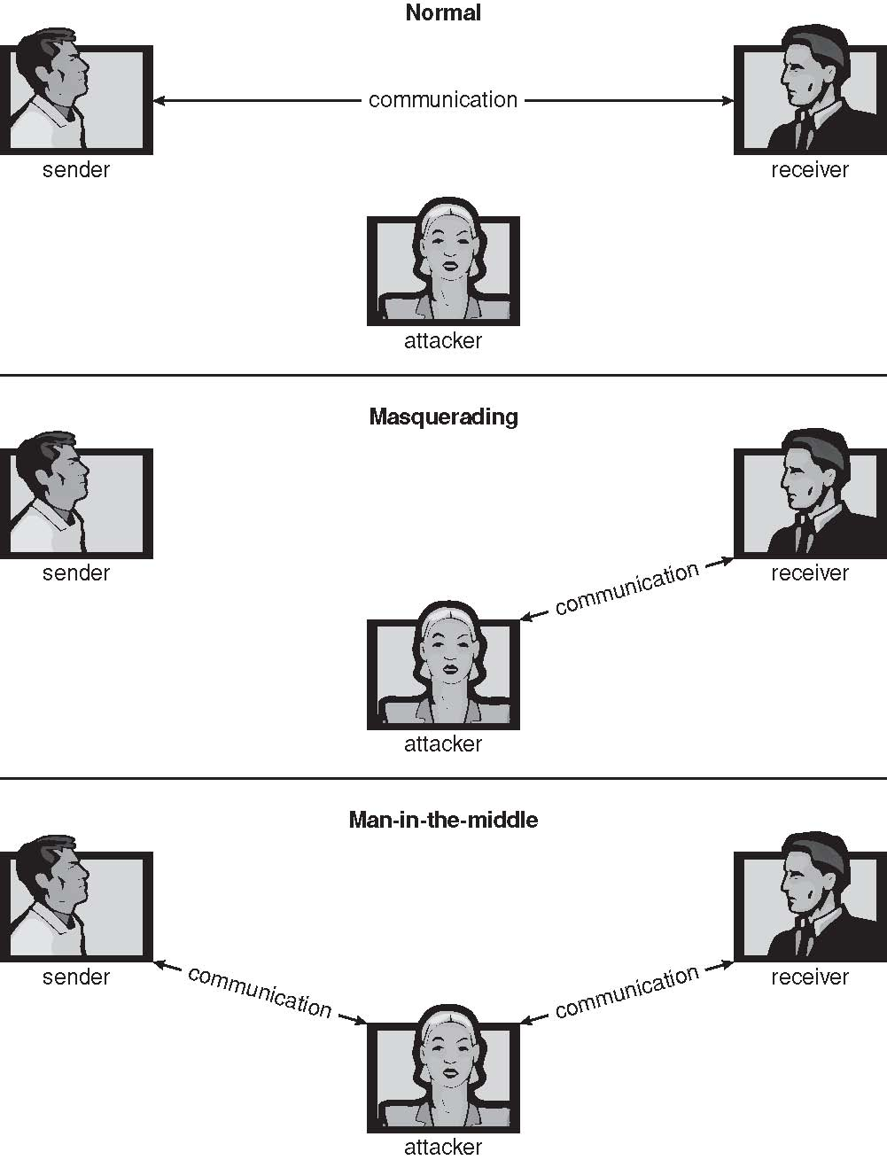
Man in the middle Attacks

Slide 5
Merkle Puzzles and privacy between internet strangers

Slide 6
privacy between internet strangers
So, let suppose Alice and Bob meet on the internet and want to exchange messages in private?
  To do so they would have to exchange keys for a symmetric encryption algorithm.
  But how can we do so over an insecure connection?
  Eve is listening.
Alice creates a set of merkle puzzles (or any time consuming mathematical problems that produces and x and y value). These problems need to take say 10 minutes.

Slide 7
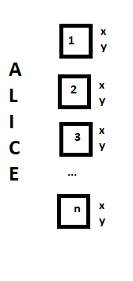
privacy between internet strangers (2)
Alice publishes a set of n puzzles (where n is likely 100+) and each puzzle takes about 10 minutes to solve.
Bob now picks one of them at random to solve.
  So, in about 10 minutes Bob sends Alice the X value.
  Alice look up the table of answers and finds out which problem Bob solved. She then uses the Y value as the temp key to encrypt and send the location of the real key.
  Bobs picks up the key and then either Alice or Bob delete it.

Slide 8
privacy between internet strangers (3)
Eve Doesn't know which puzzle bob solved, but she can see them all. And she did see which one Bob sent to Alice.
  but since she doesn't know which puzzle bob solved, she would have to solve many of them to figure out the Y key. Except it should take her longer to solve all/most of the puzzles and decrypt the second message.
    one puzzle takes 10 minutes, then 2 puzzles take 20 minutes etc.
And in theory we have established privacy between two strangers.
  But note, there is a very low possibility that Eve did solve it in time.

Slide 9
Basic encryption mechanisms

Slide 10
Cryptography
Means to constrain potential senders (sources) and / or receivers (destinations) of messages
  Based on secrets (keys)
  Enables
    Confirmation of source
    Receipt only by certain destination
    Trust relationship between sender and receiver
Note this is not in depth nor covering the math for any encryption scheme.

Slide 11
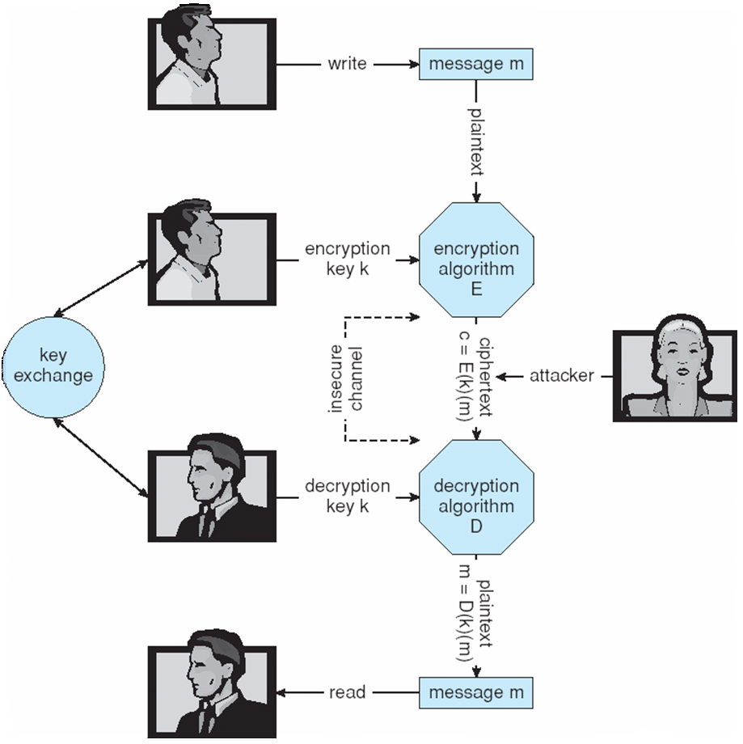
Secure Communication over Insecure Medium

Slide 12
Encryption
Encryption algorithm consists of
  Set K of keys
  Set M of Messages
  Set C of ciphertexts (encrypted messages)
  A function E : K → (M→C). That is, for each k ∈ K, E(k) is a function for generating ciphertexts from messages
    Both E and E(k) for any k should be efficiently computable functions
  A function D : K → (C → M). That is, for each k ∈ K, D(k) is a function for generating messages from ciphertexts
    Both D and D(k) for any k should be efficiently computable functions
An encryption algorithm must provide this essential property: Given a ciphertext c ∈ C, a computer can compute m such that E(k)(m) = c only if it possesses D(k)
  Thus, a computer holding D(k) can decrypt ciphertexts to the plaintexts used to produce them, but a computer not holding D(k) cannot decrypt ciphertexts
  Since ciphertexts are generally exposed (for example, sent on the network), it is important that it be infeasible to derive D(k) from the ciphertexts

Slide 13
Symmetric Encryption
Same key used to encrypt and decrypt
  E(k) can be derived from D(k), and vice versa
DES is a symmetric block-encryption algorithm (created by US Govt)
  Encrypts a block of data at a time
Triple-DES considered more secure
Advanced Encryption Standard (AES), twofish (worked on by UW math's department)
RC4 is most common symmetric stream cipher, but known to have vulnerabilities
  Encrypts/decrypts a stream of bytes (i.e., wireless transmission)
  Key is an input to psuedo-random-bit generator
    Generates an infinite keystream

Slide 14
Asymmetric Encryption
Public-key encryption based on each user having two keys:
  public key – published key used to encrypt data
  private key – key known only to individual user used to decrypt data
Must be an encryption scheme that can be made public without making it easy to figure out the decryption scheme
  Most common is RSA block cipher
  Efficient algorithm for testing whether or not a number is prime
  No efficient algorithm is known for finding the prime factors of a number

Slide 15
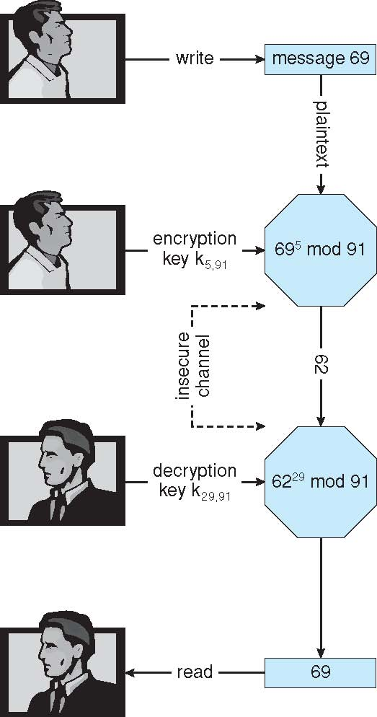
Encryption and Decryption using RSA Asymmetric Cryptography

Slide 16
Cryptography (Cont.)
Note symmetric cryptography based on transformations, asymmetric based on mathematical functions
  Asymmetric much more compute intensive
  Typically, not used for bulk data encryption

Slide 17
Authentication
Constraining set of potential senders of a message
  Complementary and sometimes redundant to encryption
  Also, can prove message unmodified
The sender encrypts the message the sender's private key.
  Now it can be decrypted with the sender's public key.
  This verifies that the sender's message and it is unchanged.
  Note, the message is not private.
  For a private authenticated messaged, sender first encrypts the message with their public key, then encrypts it with the receiver's public key.

Slide 18
Authentication – Hash Functions
Basis of authentication that the data is unchanged.
Sender creates also includes a hash of the message or data.
Common message-digest functions include MD5, which produces a 128-bit hash, and SHA-1, which outputs a 160-bit hash
  The data can be verified to be unchanged.
  common in downloading large data files.

Slide 19
Authentication – Digital Signature
Based on asymmetric keys and hashing.
A hash of the message is created.
That hash is then encrypted with the senders private key.
The encrypted hash is attached to the message
  Know as a digital signatures
Commonly used in email, but also patch delivery for OSs.
  When want authentication but not confidentiality

Slide 20
Key Distribution
Delivery of symmetric key is huge challenge
  Sometimes done out-of-band
Asymmetric keys can proliferate – stored on key ring
  Even asymmetric key distribution needs care – man-in-the-middle attack

Slide 21
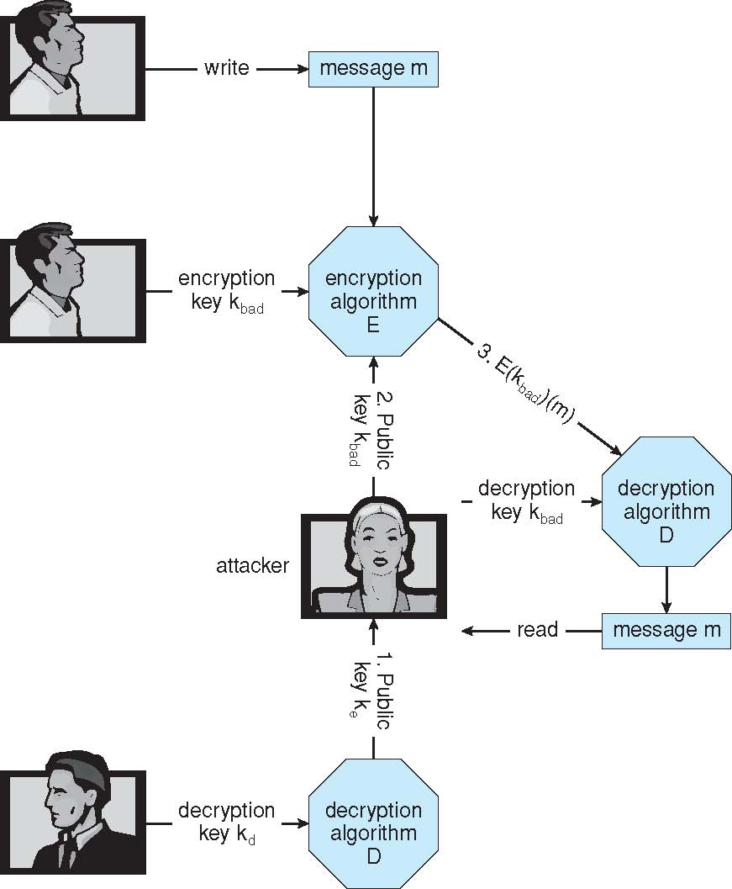
Man-in-the-middle Attack on Asymmetric Cryptography

Slide 22
Digital Certificates
Proof of who or what owns a public key
Public key digitally signed a trusted party
Trusted party receives proof of identification from entity and certifies that public key belongs to entity
Certificate authority are trusted party – their public keys included with web browser distributions
  They vouch for other authorities via digitally signing their keys, and so on

Slide 23
Blockchain

Slide 24
Blockchain
In terms of data structures:
  A literal chain of blocks…
    Everybody’s favorite! Linked lists!
Blockchains are a kind of ledger
  A ledger is just a collection of events (transactions, birthdays, criminal convictions, etc.)
each Blocks consist of two important pieces:
  An ordered collection of events from the ledger (a simple list/array)
  Most importantly, a block header (think of it as metadata)

Slide 25
Blockchain (2)
Block headers contain:
  Metadata such as the block number
  An identifying hash of the contents of the block
    e.g. 3789663396f0bb53b4ebcc527830bb8fecf95fae365851c2c1218cd803b05e56 (real hash from a real blockchain)
  The identifying hash of the previous/next blocks! Called a hash pointer
    This is how the linking happens! Hash pointers, like the memory pointers in the linked lists you’ve seen
  merkle root
    summarizes all of the data in the related transactions, and is stored in the block header. It maintains the integrity of the data. If a single detail in any of the transactions or the order of the transactions changes, so does the Merkle Root.
  a Proof-of-work (merkle puzzle basically).
    should take about 10 minutes to solve.

Slide 26
blockchain visually.

Slide 27
Where do those hashes come from?

Slide 28
Blockchain, in action
First, what do those “chunks of the ledger” look like?
Just lists of some transaction data type
  Could contain thousands of transactions
  Several megabytes in size

Slide 29
Blockchain, in action
The lists are constructed by distributing transactions across the network
If you run a bitcoin wallet on your phone, this happens:
  You get a message from another peer in the network containing a transaction
  The peer claims that the transaction is part of a certain block (they provide the hash pointer)
  You need to validate that the transaction is authentic

Slide 30
Blockchain, in action
So you have a transaction, and a hash pointer of a block…
  How do you validate it?
  Download the whole block and loop over all transactions checking equality?
    Very, very bad performance
  We use a magical tool called Merkle Trees

Slide 31
Blockchain, actually
Merkle Trees
  Leaf nodes are raw data
  2nd level up are hashes of the raw data
  Higher levels combine hashes until some root

Slide 32
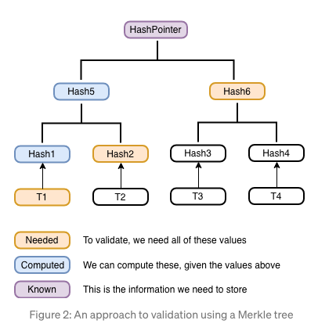
Blockchain, actually
What do Merkle Trees Give Us?
  Only need sibling hashes going up the tree to validate a given transaction!

Slide 34


Only need this stuff
Not this stuff

Slide 35
Blockchain, actually
Using Merkle Trees, we drastically reduce data needed to validate transactions
By how much?
  If a block has n transactions, then the Merkle Tree (with branching factor of 2) would be log(n) + 1 depth, including the raw data leaves.
  If we do the naïve validation, we would need to download the whole block, then do n expensive equality checks
  With Merkle Trees, we only do one hashing operation per level (log(n) + 1), using the sibling hashes that we can easily retrieve, then check equality with the “Merkle root” of the block.
  If the resulting hash and the Merkle root of the block aren’t equivalent, we call shenanigans!

Slide 36
Blockchain, philosophically
There are many that believe blockchain is a solution in search of a problem
There’s lots of cool technologies and science involved, but what does it ultimately result in? What problems is it solving?
That’s a tough question with (usually) quite subjective answers

Slide 37
Blockchain, philosophically
A lot of the methods and protocols involved in blockchain systems are still being tested and evaluated
  It’s a very young technology
The bottom line is: We’ll see what happens with it!
For the time being, it is absolutely worth studying if only for the novel challenges it presents

Slide 38
References
https://bitcoindev.network/calculating-the-merkle-root-for-a-block/
Check out that website if you’d like to try this yourself!

Slide 39
Q
A
&

