Slide 1
Cosc 2030
Text compression
using Huffman encoding.

Slide 2
ASCII table (first half only)
Dec | Hex | Binary | Char | Dec | Hex | Binary | Char | Dec | Hex | Binary | Char | Dec | Hex | Binary | Char
0 | 00 | 00000000 | NUL | 32 | 20 | 00100000 | space | 64 | 40 | 01000000 | @ | 96 | 60 | 01100000 | `
1 | 01 | 00000001 | SOH | 33 | 21 | 00100001 | ! | 65 | 41 | 01000001 | A | 97 | 61 | 01100001 | a
2 | 02 | 00000010 | STX | 34 | 22 | 00100010 | dbl space | 66 | 42 | 01000010 | B | 98 | 62 | 01100010 | b
3 | 03 | 00000011 | ETX | 35 | 23 | 00100011 | # | 67 | 43 | 01000011 | C | 99 | 63 | 01100011 | c
4 | 04 | 00000100 | EOT | 36 | 24 | 00100100 | $ | 68 | 44 | 01000100 | D | 100 | 64 | 01100100 | d
5 | 05 | 00000101 | ENQ | 37 | 25 | 00100101 | % | 69 | 45 | 01000101 | E | 101 | 65 | 01100101 | e
6 | 06 | 00000110 | ACK | 38 | 26 | 00100110 | & | 70 | 46 | 01000110 | F | 102 | 66 | 01100110 | f
7 | 07 | 00000111 | BEL | 39 | 27 | 00100111 | ' | 71 | 47 | 01000111 | G | 103 | 67 | 01100111 | g
8 | 08 | 00001000 | BS | 40 | 28 | 00101000 | ( | 72 | 48 | 01001000 | H | 104 | 68 | 01101000 | h
9 | 09 | 00001001 | HT | 41 | 29 | 00101001 | ) | 73 | 49 | 01001001 | I | 105 | 69 | 01101001 | i
10 | 0A | 00001010 | LF | 42 | 2A | 00101010 | * | 74 | 4A | 01001010 | J | 106 | 6A | 01101010 | j
11 | 0B | 00001011 | VT | 43 | 2B | 00101011 | + | 75 | 4B | 01001011 | K | 107 | 6B | 01101011 | k
12 | 0C | 00001100 | FF | 44 | 2C | 00101100 | , | 76 | 4C | 01001100 | L | 108 | 6C | 01101100 | l
13 | 0D | 00001101 | CR | 45 | 2D | 00101101 | - | 77 | 4D | 01001101 | M | 109 | 6D | 01101101 | m
14 | 0E | 00001110 | SO | 46 | 2E | 00101110 | . | 78 | 4E | 01001110 | N | 110 | 6E | 01101110 | n
15 | 0F | 00001111 | SI | 47 | 2F | 00101111 | / | 79 | 4F | 01001111 | O | 111 | 6F | 01101111 | o
16 | 10 | 00010000 | DLE | 48 | 30 | 00110000 | 0 | 80 | 50 | 01010000 | P | 112 | 70 | 01110000 | p
17 | 11 | 00010001 | DC1 | 49 | 31 | 00110001 | 1 | 81 | 51 | 01010001 | Q | 113 | 71 | 01110001 | q
18 | 12 | 00010010 | DC2 | 50 | 32 | 00110010 | 2 | 82 | 52 | 01010010 | R | 114 | 72 | 01110010 | r
19 | 13 | 00010011 | DC3 | 51 | 33 | 00110011 | 3 | 83 | 53 | 01010011 | S | 115 | 73 | 01110011 | s
20 | 14 | 00010100 | DC4 | 52 | 34 | 00110100 | 4 | 84 | 54 | 01010100 | T | 116 | 74 | 01110100 | t
21 | 15 | 00010101 | NAK | 53 | 35 | 00110101 | 5 | 85 | 55 | 01010101 | U | 117 | 75 | 01110101 | u
22 | 16 | 00010110 | SYN | 54 | 36 | 00110110 | 6 | 86 | 56 | 01010110 | V | 118 | 76 | 01110110 | v
23 | 17 | 00010111 | ETB | 55 | 37 | 00110111 | 7 | 87 | 57 | 01010111 | W | 119 | 77 | 01110111 | w
24 | 18 | 00011000 | CAN | 56 | 38 | 00111000 | 8 | 88 | 58 | 01011000 | X | 120 | 78 | 01111000 | x
25 | 19 | 00011001 | EM | 57 | 39 | 00111001 | 9 | 89 | 59 | 01011001 | Y | 121 | 79 | 01111001 | y
26 | 1A | 00011010 | SUB | 58 | 3A | 00111010 | : | 90 | 5A | 01011010 | Z | 122 | 7A | 01111010 | z
27 | 1B | 00011011 | ESC | 59 | 3B | 00111011 | ; | 91 | 5B | 01011011 | [ | 123 | 7B | 01111011 | {
28 | 1C | 00011100 | FS | 60 | 3C | 00111100 | < | 92 | 5C | 01011100 | \ | 124 | 7C | 01111100 | |
29 | 1D | 00011101 | GS | 61 | 3D | 00111101 | = | 93 | 5D | 01011101 | ] | 125 | 7D | 01111101 | }
30 | 1E | 00011110 | RS | 62 | 3E | 00111110 | > | 94 | 5E | 01011110 | ^ | 126 | 7E | 01111110 | ~
31 | 1F | 00011111 | US | 63 | 3F | 00111111 | ? | 95 | 5F | 01011111 | _ | 127 | 7F | 01111111 | DEL
Notes:
https://www.rapidtables.com/code/text/ascii-table.html

Slide 3
Representation
all the characters, letters, punctuation, whitespace, and "other" are represented in 8 bits.
  More if you are using Unicode is 16 bits or UTF-8
    UTF-8 is a variable width character encoding capable of encoding all 1,112,064 codes up to 4 bytes
let's stick with just standard English text file for the moment.
  First do we even need all 8 bits?
    hint, 127 was listed on the last page
  All the punctuation and whitespace?
    hint, look at the first 16 positions.
fewer bits per letter and we have the basic idea of lossless compression.

Slide 4
Representation (2)
What if we only need to represent this:
csu sucks!
ASCII 8 bit encoding
Char | ASCII | Binary
c | 99 | 01100011
S | 115 | 01110011
u | 117 | 01110101
Space | 64 | 01000000
k | 107 | 01101011
! | 65 | 01000001
10 characters at 8bits, requires 80 bits.
Ward 3 bit encoding
Char | Code | Binary
c | 0 | 000
S | 1 | 001
u | 2 | 010
Space | 3 | 011
k | 4 | 100
! | 5 | 101
10 characters at 3 bits, requires 30 bits

Slide 5
text compression
We would like to find a more generic way, to do text compression (or general compression).
  one that has a set of unique encoding for each character and can be easily encoded and decoded.
David Huffman, when he was doctorial student at MIT in 1952, developed Huffman coding.
  We can get encoding and decoding of text. many compression programs (like say winzip) use this as compression for text files.

Slide 6
algorithm
With the uncompressed text
  count the frequency of the characters.
  use the frequency, build a binary tree with high frequency letter at or near the top, lower frequency characters near the bottom.
  Use the final tree to encode the characters.
with compressed/encoded text
  use the tree developed before to decode the characters.

Slide 7
first
frequency count for
  csu sucks!
'c' 2
's' 3
'u' 2
' ' 1 (space)
'k' 1
'!' 1

Slide 8
encoding tree (original version)
To create the tree we create a set of tree. All the trees are one node with the weight of tree equal to number of characters.
  IE '!' weighted 1 and 'c' weighted 2
repeat this step until there is only one tree
  choose two trees with the smallest weights and create a new tree whose root has the weight of the combined tree.

Slide 9
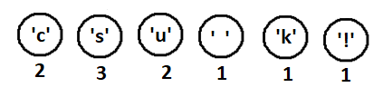
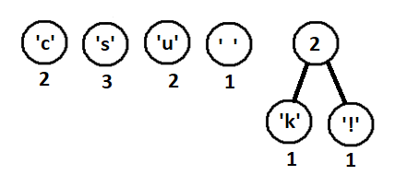
Example
weighted one node trees
Now combine 2 lowest trees
together.
and repeat.

Slide 10
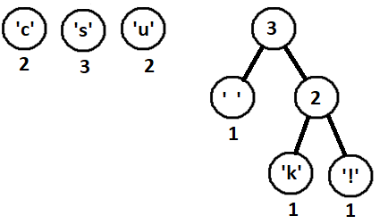
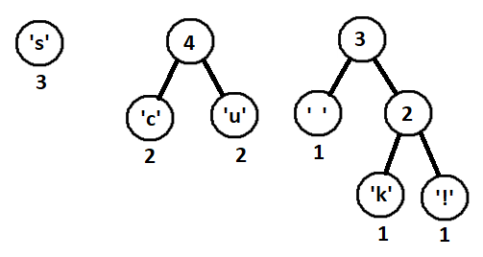
Example (2)
next ' ' is 1 and k! tree is 2
c is 2 and u is 2, so combine
them next

Slide 11
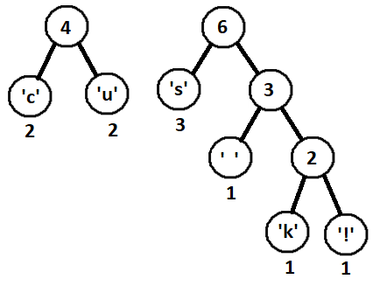
example (3)
next s 3 with 3 tree

Slide 12
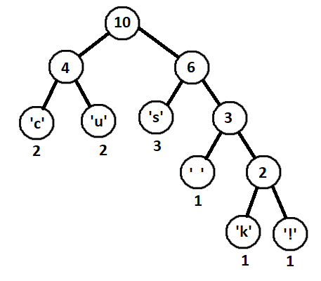
example (4)
finally combine the last two trees into a final tree.

Slide 13
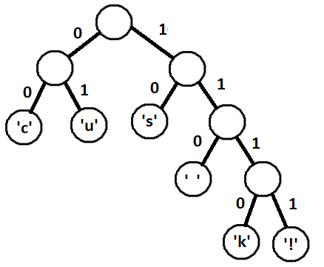
Using the tree for encoding.
When we look for letter going down the tree
  left: it's an 0,
  right: it's a 1
00 c
01 u
10 s
110 space
1110 k
1111 !

Slide 14
Encoding our string
'csu sucks!' would look like this
0010011101001001110101111
so it can be stored as 25 bits.

Slide 15
decoding
so how do decode this:
0010011101001001110101111
read down the tree using left and right again for 0 and 1. When we get to a leaf, it's that letter.
So
00 c 10s 01u 110space 10s 01u 00c 1110k 10s 1111!

Slide 16
Problem!
To decode, we either have already know the tree or store the tree with the compressed data.
  In most compressed files there a header section with the tree.
  There are a couple of options to store it
  store the frequency count and the use the same algorithm to rebuild the tree. Can you see any problems here?
  Use a "standard" character frequency count for any language, so say English. Again, see the problem here? The advantage?
  store the tree in a pre-order traversal, writing out each node
    need to know leafs from non. So say 1 for internal 0 for leaf and store the character too.
    could look like this: 0 0 1c 1u 0 1s 0 0' ' 0 1k 1!
    advantage? disadvantage?

Slide 17
Node data structure
The node data structure is going to have to have something like this
  char data;
  int freq; //maybe long unsigned (we can't have negative counts)
  bool internal (could just check if left and right are nullptrs well)
  node * left
  node * right

Slide 18
second tree option
We use a different data structure, which is easier to write out as it is already an array.
Binary Heap (max heap/priority queue) as an array. It is easy to serialize, since it is complete.
  like before, we need internal nodes with just the combined priority
  but more complex, because we would all be inserting a partial priority trees too.
downside to a complete tree, it will like not be the most optimized.

Slide 19
Q
A
&

